Slide 1
Screening Germplasm and Breeding Soybeans for Flood Tolerance
Screening Germplasm and Breeding Soybeans for Flood Tolerance
Research Progress
Pengyin Chen, Leandro Mozzoni, Daryl Chastain, Tessie Wilkerson, Blair Buckley, Mo Way

Slide 2
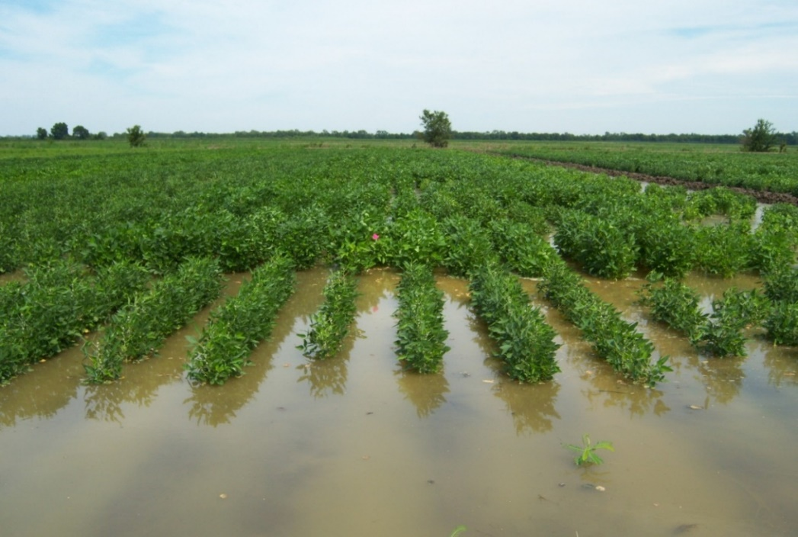
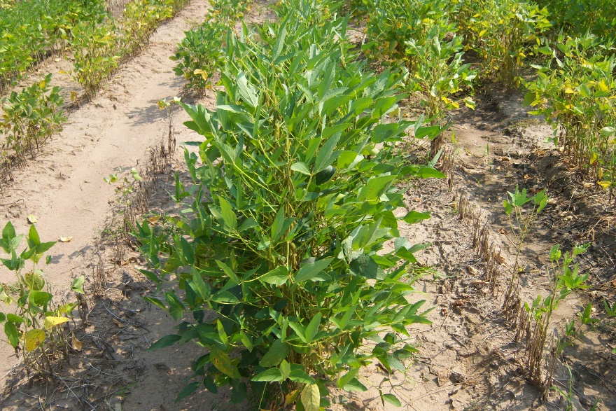
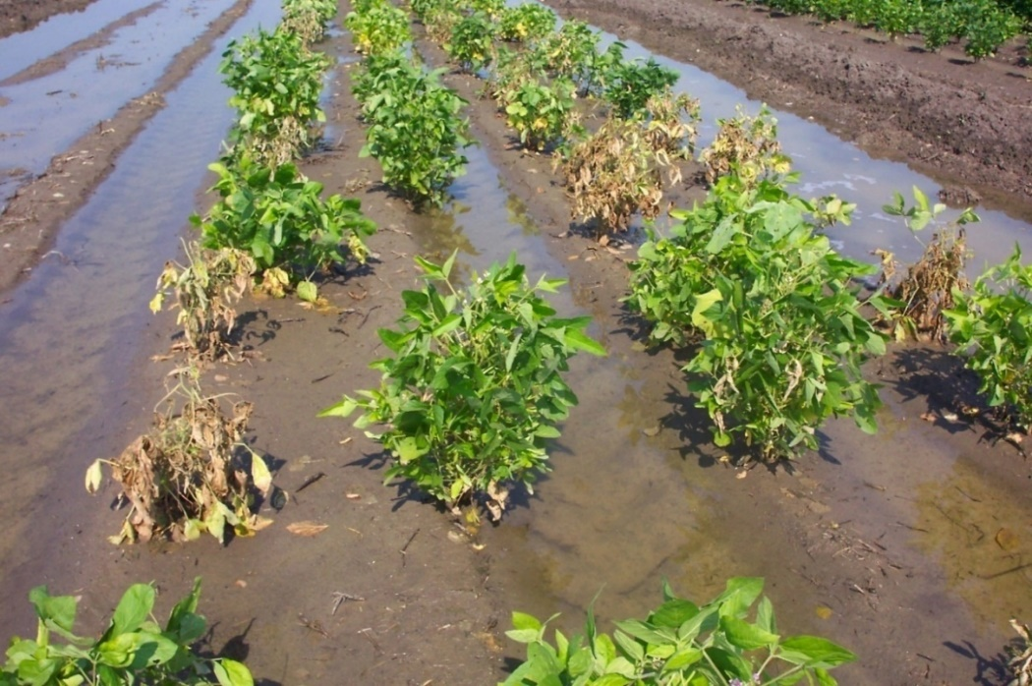
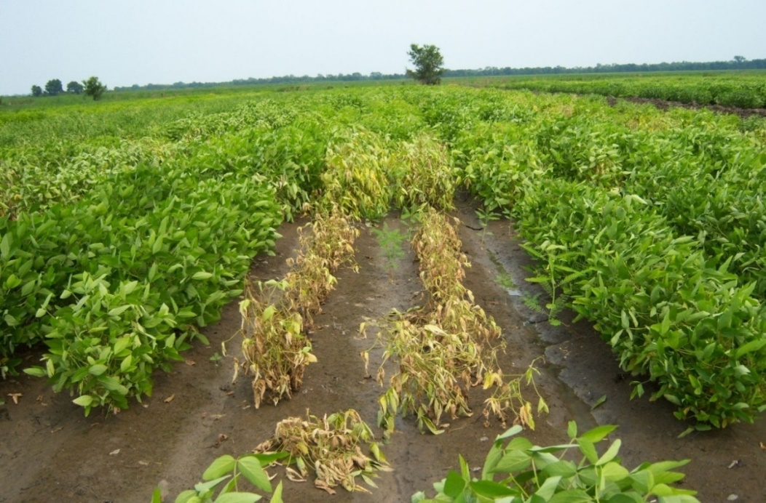
Flood Tolerance

Slide 3
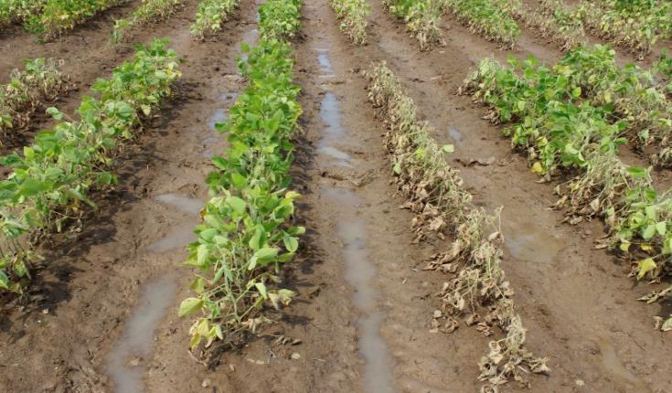
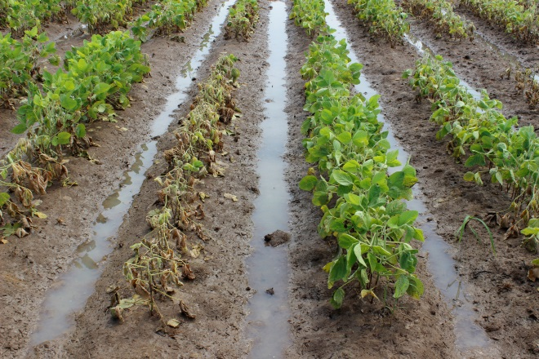
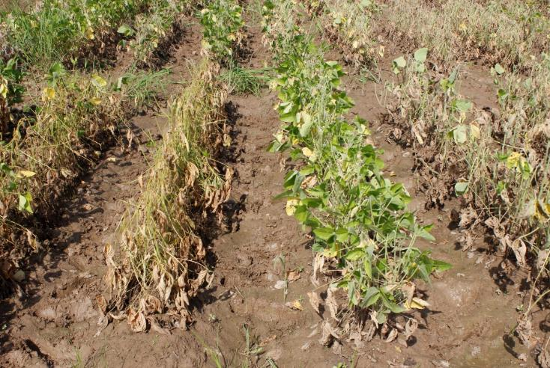
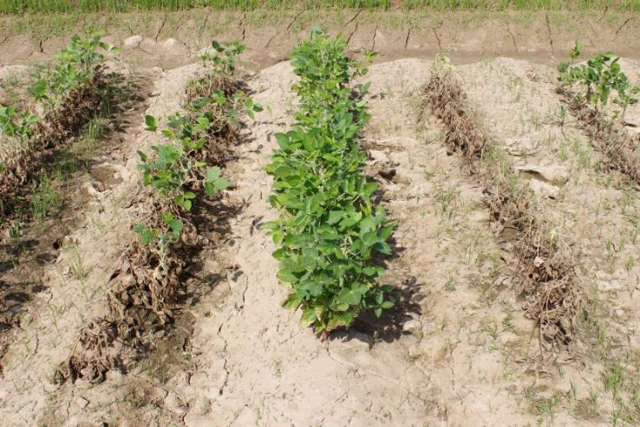
Visual Symptoms and Rating Scale
6
4
3
2
9
8
1
9
5
7
1
9

Slide 4
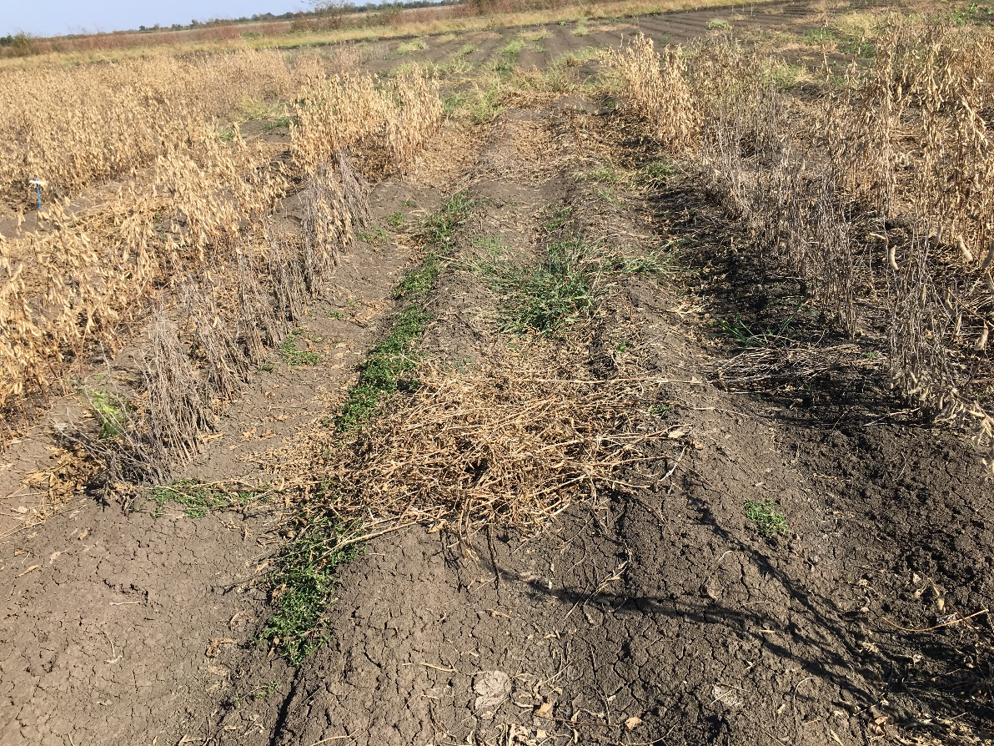
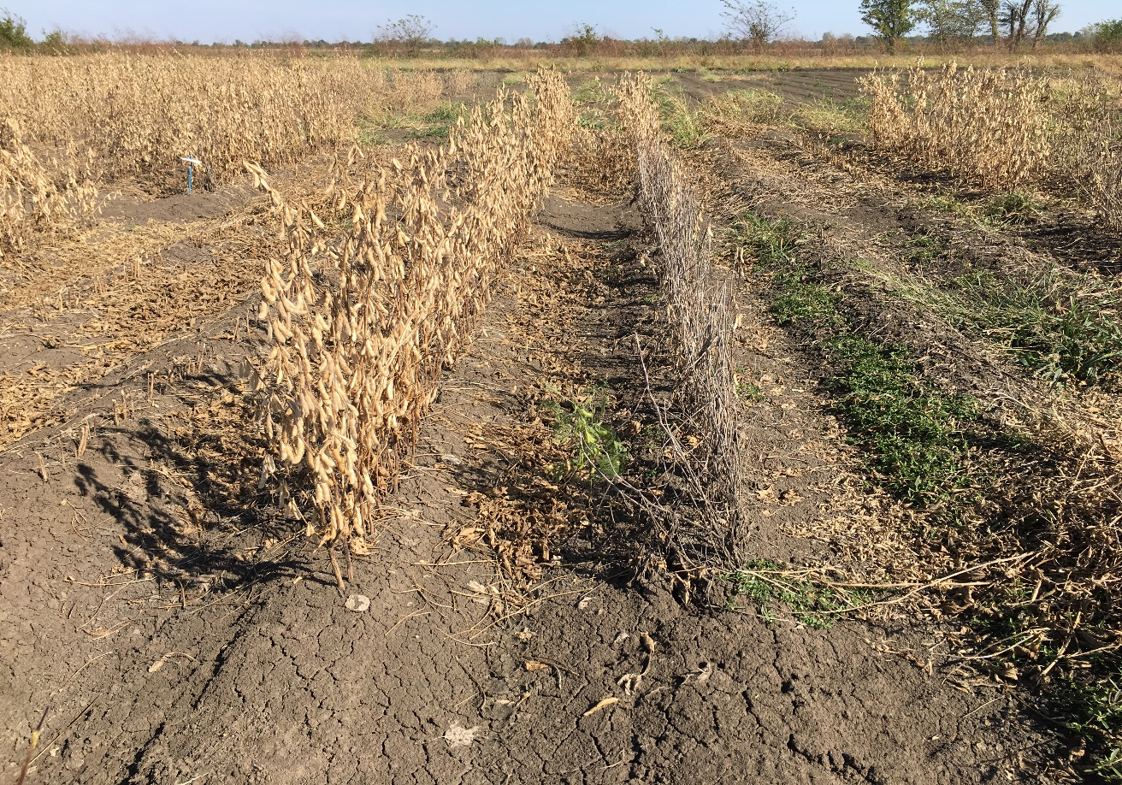
Flood Yield Plots – Portageville, MO

Slide 5
Yield comparison of PI 408105A derived lines vs. check under flooding
Line (1st cycle breeding) | BU/A under flood
S11-25108 (S99-2281 x PI 408105A) | 23.5
S11-25615 (S99-2281 x PI 408105A) | 26.8
Asgrow check AG 4835 | 11.7
Line (2nd cycle breeding) | BU/A under flood
S15-19625 (S11-25108 x S05-11482) | 37.1
S15-19719 (S11-25108 x S05-11482) | 35.7
Asgrow check AG4835 | 5.9

Slide 6
MG 4 Flood Tolerant Breeding Lines Identified in 2018 Test
Name | FTS | Non-Flooded Yield (Bu/ac) | PRR | Released
S14-9051R | 1.7 | 52.2 | Field tolerant
S13-10590C | 2.5 | 48.1 | Field tolerant | 2019
S13-10592C | 2.3 | 47.1 | Field tolerant | 2019
S14-15146R | 2.0 | 48.3 | Field tolerant | 2017
S16-11644 | 2.3 | 50.8 |  | 2020
S99-2281 (Sus Ck) | 3.7 | 46.7
AG4835 (Ck) | 4.0 | 43.6
AG 5335 (Ck) | 3.7 | 49.9
AG 51X8 (Ck) | 4.7 | 48.4
Note: Flooded expt. was not harvested due to excessive rain and muddy field

Slide 7
MG 5 Flood Tolerant Breeding Lines Identified in 2018 Test
Name | FTS | Non-flooded yield (Bu/ac) | PRR | Released
S14-16306 | 1 | 38.9
S14-16267 | 1.7 | 40.0
S11-20124C | 2 | 48.5 (Also drought tolerant) | Field tolerant | 2016
S12-1362 | 2.7 | 43.5
S14-16331 | 2 | 39.3
S99-2281 (Sus Ck) | 4.0 | 43.7
AG 51X8 (Ck) | 4.7 | 44.5
Note: Flooded expt. was not harvested due to excessive rain and muddy field

Slide 8
2019 Selections from AYT FT- MG 4
Based of flood tolerance score (FTS) and yield
No. lines tested: 17
Name | FTS | Flooded Yield (b/a) | Non-Flooded Yld (b/a) | Remarks
S16-7922C | 1.3 | 26 | 59 | New release
S17-1146 | 1.0 | 26 | 55
S16-11644C | 1.3 | 23 | 59 | New release
S17-6018 | 2.3 | 22 | 53
S13-15999 | 2.3 | 20 | 45
S16-14379C | 1.0 | 19 | 56
S99-2281 (Sus Ck) | 4.0 | 16 | 46

Slide 9
2019 Selections from AYT FT-MG 5
Based on FTS and yield
No. of Lines tested: 17
Name | FTS | Flooded Yld (b/a) | Non-flooded Yld (b/a) | Remarks
S16-3739RY | 1.0 | 26 | 63 | 2019 UT
S12-1362 | 1.3 | 25 | 61
S17-5786 | 1.7 | 24 | 61
S16-15170C | 1.3 | 23 | 71 | 2019 UT
S16-15809C | 2.3 | 24 | 63
S16-3747R | 2.0 | 22 | 64
S99-2281 (Sus. Ck) | 4.0 | 16 | 52

Slide 10
2019 Selections from PYT FT-MG 5, Set 1
Based on FTS & Yield
No. lines tested: 17
Name | FTS | Flooded Yld (b/a) | Non-flooded Yld (b/a)
S18-3460 | 1.5 | 26 | 69
S18-3431 | 1 | 22 | 72
S18-3469 | 1 | 22 | 61
S18-3414 | 1 | 22 | 62
S18-3403 | 1 | 21 | 65
S99-2281 (Sus ck) | 4 | 12 | 39

Slide 11
2019 Selections from PYT FT-MG 5, Set 2
Based on FTS & Yield
No. lines tested: 17
Name | FTS | Flooded Yld (b/a) | Non-flooded Yld (b/a)
S18-3519 | 1.5 | 24 | 57
S18-3520 | 1 | 22 | 60
S18-3555 | 1 | 24 | 55
S18-3616 | 1.5 | 22 | 56
S18-3616 | 1.5 | 22 | 56
S99-2281 (Sus ck) | 4 | 15 | 40

Slide 12
Summary Results - Screening Breeding Lines
No of lines: 100
Advanced lines were developed in UM and UA
No. of lines | FTS
16 | 1.0 - 2.0
16 | 2.1 - 2.5
46 | 2.7 - 3.5
22 | 3.7 - 4.7

Slide 13
Screening Breeding Lines Contd.
18 Lines Exhibited FTS Score 1.0 - 2.0
Lines | FTS |  | Lines | FTS
S16-14379C | 1.3 |  | S16-14928C | 1.7
S16-7922 | 1.3 |  | S11-20124 | 1.7
S16-15170C | 1.0 |  | R15-7016 | 1.7
S17-19874R | 1.0 |  | UA 5814HP | 1.7
S16-15896C | 1.3 |  | S15-3772RY | 2.0
S16-11222 | 1.3 |  | S16-3747 | 2.0
R15-7016 | 1.7 |  | S16-14457C | 2.0
R15-7025 | 1.3 |  | S15-5909 | 2.0
UA 5814HP | 1.7 |  | R15-8014 | 2.0
FTS: Flood tolerance score

Slide 14
Evaluation of Tolerant vs. Sensitive Lines
8 lines were tolerant while 12 lines were sensitive
Obj: To study the effect of flooding stress on yield and seed composition
Name | FTS | Yld Flooded (b/a) | Yld Non-flooded (b/a) |  | Name | FTS | Yld Flooded (b/a) | Yld Non-flooded (b/a)
S15-3772RY | 1.3 | 20 | 38 |  | UA5615C | 2.7 | 12 | 47
S11-20124C | 1.7 | 14 | 35 |  | UA5014C | 2.7 | 13 | 37
R04-342 | 1.7 | 17 | 46 |  | R07-6669 | 2.7 | 13 | 43
R06-4433 | 1.7 | 19 | 50 |  | R01-2731F | 2.7 | 11 | 29
R11-6870 | 1.7 | 15 | 43 |  | S12-4718C | 3.0 | 15 | 55
S13-15999 | 2.0 | 12 | 33 |  | S14-9051R | 3.3 | 8 | 14
S14-16331 | 2.0 | 15 | 30 |  | S13-10592C | 3.3 | 9 | 16
R03-1250 | 2.0 | 13 | 50 |  | R01-581F | 3.3 | 13 | 40
Mean | 1.8 | 16 | 41 |  | UARK-5896 | 3.3 | 5 | 36
 |  |  |  |  | S13-1955C | 3.7 | 14 | 39
 |  |  |  |  | S13-2743C | 4.0 | 9 | 15
 |  |  |  |  | S99-2281 | 4.3 | 12 | 38
 |  |  |  |  | Mean | 3.3 | 11 | 34

Slide 15
Screening Missouri Commercial Varieties
No of lines screened: 180
Lines with Lines with FTS 1.0 to 1.3
Name | Company | FTS |  | Name | Company | FTS
DG52X05 | Delta Grow | 1.0 |  | LS4565XS | Local Seed | 1.3
4677NXS | Midland | 1.0 |  | 7478XTS | USG | 1.3
4956NXS | Midland | 1.0 |  | V 4920S | GDM Seeds | 1.3
DG48X45 | Delta Grow | 1.0 |  | S11-20337GT | MCIA | 1.3
LSX4901X | Local Seed | 1.0 |  | MS 4846 RXT | MorSoy | 1.3
7489XT | USG | 1.0 |  | WXX3487NS | Willcross | 1.3
471E19S | Go Soy | 1.0 |  | 44U4LL | AgVenture | 1.3
SA13-1385 | MCIA | 1.0 |  | S42EN89 | Dyna-Grow | 1.3
 |  |  |  | S43XS70 | Dyna-Grow | 1.3
FTS: Flood tolerance score

Slide 16
2019 Selections from Progeny Row Testing
432 breeding lines of F_{4:5} generation grown
53 lines were selected
Cross # | Parentage | # lines selected
S17-652 | S14-16235 (FT) × S13-3851 | 11
S17-653 | S14-16267 (FT) × S15-12003 | 13
S17-669 | S14-16267 (FT) × V12-0045 R2 | 17
S17-659 | S13-1955 × S16-16842 (FT) | 12

Slide 17
Breeding Populations Under Development
Generation is being advanced in winter nurseries
Cross # | Parentage | Generation | Year of Evaluation | Obj.
S18-298 | S11-20124 × R04-342 (FT) | F₄ | 2020/21 | Variety Dev.
S18-304 | S14-16331 (FT) × S11-9618RR2 | F₄ | 2020/21 | Variety Dev.
S18-305 | S14-16306 (FT) × S13-3851C | F₄ | 2020/21 | Variety Dev.
S18-306 | RIL 123 (FT) × S11-20337GT | F₄ | 2020/21 | Variety Dev.
S18-307 | R07-6669 (FT) × S11-20195GT | F₄ | 2020/21 | Variety Dev.
S18-308 | UA 5615C (FT) × S15-3772RY | F₄ | 2020/21 | Variety Dev.
S18-310 | S14-16267 (FT) × S16-14558 | F₄ | 2020/21 | Variety Dev.
S18-311 | S12-1362 (FT) × S16-14687 | F₄ | 2020/21 | Variety Dev.
S18-312 | R10-4892 (FT) × S16-14379 | F₄ | 2020/21 | Variety Dev.
S18-313 | RIL 48 (FT) × S16-14730 | F₄ | 2020/21 | Variety Dev.
S18-486 | S12-1362 (FT) × S14-9017 | F₄ | 2020/21 | Variety Dev.
S18-487 | S12-1362 (FT) × S13-3851C | F₄ | 2020/21 | Variety Dev.

Slide 18
Crosses Made in 2019 Season
F₁ seeds sent to the winter nurseries to advance generation
Objectives: Development of new germplasm and varieties
Cross | Pedigree | Status | Year of Evaluation
S19-822 | S11-16653 x R04-342 (FT) | F₁ | 2021-22
S19-829 | S14-16331 (FT) x S15-10434C | F₁ | 2021-22
S19-832 | R07-6669 (FT) x S15-3772RY | F₁ | 2021-22
S19-833 | S14-16235 (FT) x S16-8898C | F₁ | 2021-22
S19-836 | R10-4892 (FT)x S13-3851C | F₁ | 2021-22
S19-837 | RIL 48 (FT) x S11-20356GT | F₁ | 2021-22
S19-838 | S13-15999 (FT)x S11-20337GT | F₁ | 2021-22
S19-839 | R11-6870 (FT) x S11-20195GT | F₁ | 2021-22
S19-823 | S15-10879 x PI 597459 C (FT) | F₁ | 2021-22
S19-851 | S13-3851C x PI 597459 (FT) | F₁ | 2021-22
S19-853 | S15-5904RY x PI 597459 (FT) | F₁ | 2021-22
S19-854 | S15-5904RY x PI 407229 (FT) | F₁ | 2021-22
S19-855 | S13-2743LL x PI 424102A (FT) | F₁ | 2021-22

Slide 19
Screening Germplasm and Breeding
Soybeans for Flood Tolerance
Research Plan for 2020
Pengyin Chen
University of Missouri-Delta Research Center

Slide 20
Advanced Yield Trial MG 4
No. lines expected to be included: 16
6 lines selected from 2019 AYT-MG4
10 UM breeding lines from the 2019 UT/UP Southern
Advanced Yield Trial MG 5
No. of lines expected to be included: 16
6 breeding lines selected from 2019 AYT-MG 5
4 breeding lines selected from 2019 PYTs
6 UM lines from the UT/UP Southern 2019
Both trials:
To be grown in flooded & non-flooded fields
12’ 4-row plots, 3 reps
1 Standard susceptible check: S99-2281
3 Commercial varieties

Slide 21
Preliminary Yield trial MG 4-5, Set 1
No. Lines: 26 (Conv)
- 20 lines selected from 2019 progeny testing of 3 populations.
S17-652 (S14-16235 (FT) × S13-3851), S17-653 (S14-16267 (FT) × S15-12003),
and S17-659 [S13-1955 × S16-16842 (FT)].
- 6 lines selected from 2019 PYT
Preliminary Yield Trial MG 4, Set 2
No. of lines: 17 (R2Y)
- 17 lines selected from 2019 progeny testing of the population:
S17-669 [S14-16267 (FT) x V12-0045 R2].
Both trials:
Will be grown in two locations (flooded and non-flooded)
12’ 2-row plots, 2 reps
1 standard susceptible check (S99-2281)
1 tolerant check (S12-1362)
2-5 commercial varieties as checks

Slide 22
Screening Advanced Breeding lines for FT
No of anticipated lines: 80-100
- 32 lines that showed FTS of 1-2.5 in 2019 screening test
- 50 to 60 new lines to be selected from 2019 AYTs from MU and UA
Screening Missouri Commercial Varieties
No. of lines anticipated: 100
Both screenings:
7’ 1-row plots, 3 replications
2 standard checks (1 susceptible & 1 tolerant)
3 popular commercial varieties

Slide 23
Progeny Rows Testing
About 1200-1400 single plant progenies of 10-12 F_{4:5} populations
F_{4:5} seeds are expected to be arrived Portageville, MO from winter
nurseries in May, 2020
Crosses under Generation Advance
13 crosses made in 2019 will be advanced to F2/ F3 generation
In Costa Rica and Puerto Rico
New Crossing Plan in 2020
Parents:
New high-yielding elite breeding lines
Flood tolerant PIs and breeding lines
10-15 new crosses will be made

Slide 24
Screening Soybean Germplasm and Breeding Soybeans for Flood Tolerance
University of Arkansas

Slide 25
19 MSSB Flood Screening in AR (1 location, Stuttgart)
Expt | Plot | Location | Rep | Stage | MAT/Block
Flood Yield Test (Flooding) | 2 Rows (15’) | STU | 3 | R1 | No
Flood Yield Test (Irrigation) | 2 Rows (15’) | STU | 3 | R1 | No
MSSB High-yielding Lines | Row (5’) | STU | 5 | R1 | No
AR VT4 | Row (5’) | STU | 5 | R1 | No
AR VT5 | Row (5’) | STU | 5 | R1 | No
PIFS | Row (5’) | STU | 5 | V2/R1 | No
FLP1 | Row (5’) | STU | 5 | R1 | No
FLP2 | Row (5’) | STU | 5 | R1 | No
Pre-Foundation (PFFS) | Row (5’) | STU | 5 | V2 | No
ARV-Early (ARVEFS) | Row (5’) | STU | 5 | V2 | No
ARV-Late (ARVLFS) | Row (5’) | STU | 5 | V2 | No

Slide 26
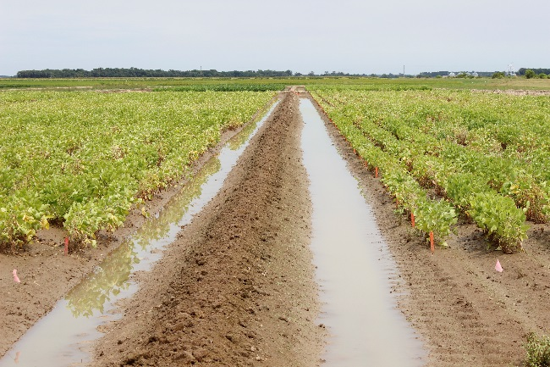
2019 Flood Screening Method
Single short row screening in Stuttgart, AR
Plot: 5 ft single row, 50 seeds per row, 5 reps
Treatment: partial submergence, 10 – 16 cm, 8-11 days
Flooding stage: V2 or R1
Flood tolerance visual score:
1) Flood severity score (FSS): Median percent of chlorosis and/or
necrosis for plot, on a 0-9 scale
2) Flood incidence score (FIS): Percent of plants in the plot with
any level of flood symptoms, on a 0-100% scale
Flood tolerance remote sensing score:
Drone-mounted NDVI and NRDE sensors
Data collection:
7 -10 days after flooding

Slide 27
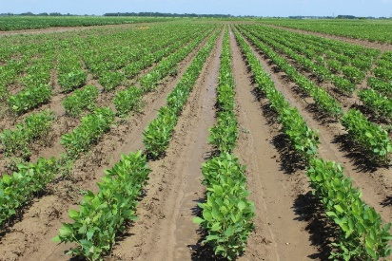
100 MO and AR High-yielding Lines (R1 stage, 5 reps, 10-day flooding)
Name | Flood Severity Score (FSS) | Flood Incidence Score (FIS) %
R14-14314 | 3.8 | 46.0
S15-3772RY | 4.0 | 52.0
R16-45 | 4.2 | 46.0
S15-5909 | 4.4 | 50.0
R13-1409 | 4.4 | 52.0
R07-6669 | 4.8 | 58.0
S16-3739 | 4.8 | 56.0
. | . | .
Grand Mean | 6.7 | 74.5
Commercial Check Mean | 6.1 | 66.0
CV | 23.3 | 21.5
LSD | 1.9 | 19.9
One line showed good flood tolerance (FSS<4.0).
Six lines showed moderately flood tolerance (FSS<5.0).

Slide 28
45 Commercial Varieties (MG-4) (R1 stage, 5 reps, 10-day flooding)
Name | Flood Severity Score (FSS) | Flood Incidence Score (FIS) %
Credenz CZ 4869X | 1.6 | 26.0
ARMOR X48D88 | 2.0 | 28.0
ARMOR X49D67 | 2.4 | 32.0
Eagle Seed ES 4460RYX | 2.4 | 34.0
Delta Grow 46E29 | 2.8 | 34.0
Delta Grow 49E29 | 2.8 | 38.0
Credenz CZ 4979X | 2.8 | 34.0
Delta Grow 46X25 | 2.8 | 36.0
. | . | .
Grand Mean | 4.6 | 52.5
CV | 30.2 | 27.4
LSD | 1.7 | 18.0
Eight varieties showed high flood tolerance (FSS<3.0).

Slide 29
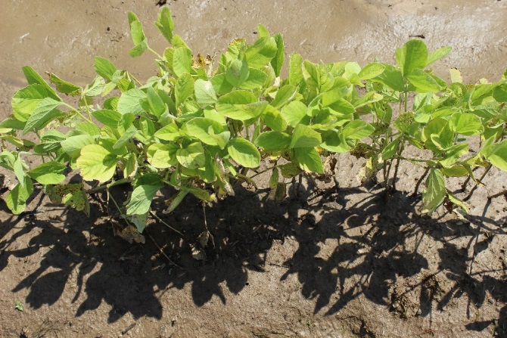
20 Commercial Varieties (MG-5) (R1 stage, 5 reps, 10-day flooding)
Name | Flood Severity Score (FSS) | Flood Incidence Score (FIS) %
Credenz CZ 5150LL | 3.6 | 40.0
Eagle Seed ES 5155RYX | 3.8 | 42.0
. | . | .
Grand Mean | 5.7 | 63.0
CV | 43.5 | 41.1
LSD | 3.1 | 32.6
Two varieties showed good flood tolerance (FSS<4.0).

Slide 30
62 AR Historical Varieties/Germplasm (MG-4,5) (V2 stage, 2 tests, 5 reps, 8-day flooding)
Name | Flood Severity Score (FSS) | Flood Incidence Score (FIS) %
R10-298 | 2.6 | 36.0
UA 5014C | 2.6 | 34.0
R13-13997 | 3.4 | 42.0
UA 5414RR | 3.6 | 44.0
Ozark | 3.8 | 46.0
. | . | .
Grand Mean | 4.4/6.1 | 53.2/70.5
Commercial Check Mean | 4.6/6.7 | 53.5/77.5
CV | 29.5/31.0 | 27.6/27.8
LSD | 1.7/2.4 | 18.5/24.5
Five lines showed good flood tolerance at V2 stage (FSS<4.0).

Slide 31
36 High-yielding Pre-foundation Lines (V2 stage, 5 reps, 8-day flooding)
Name | Flood Severity Score (FSS) | Flood Incidence Score (FIS) %
R16-2547 | 3.8 | 48
R16-1445 | 4.6 | 54
R16-39 | 4.6 | 56
R16-6270 | 5.4 | 64
R04-342 | 5.4 | 64
R15-7063 | 5.6 | 64
R11-6870 | 5.8 | 66
. | . | .
Grand Mean | 6.8 | 77
CV | 26.9% | 24.0%
LSD | 1.8 | 18.4
One lines showed good flood tolerance at V2 stage (FSS<4.0).

Slide 32
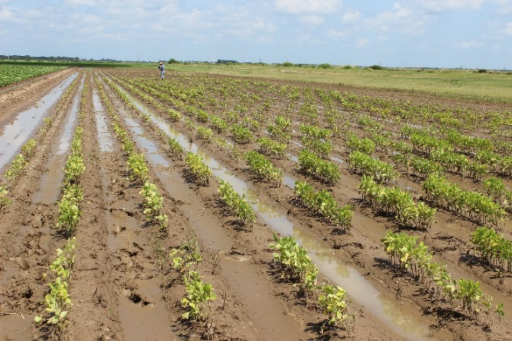
2019 AR Flood Breeding Overview
Regional Trials | 36 Advanced lines
Preliminary Test | 288 lines
Progeny Rows | 336 rows (4 populations)
 | → 62 selected
F₄ | 6 populations
F₃ | 4 populations
F₂ | 7 populations
F₁ | 9 populations
New Crosses | 5 combinations

Slide 33
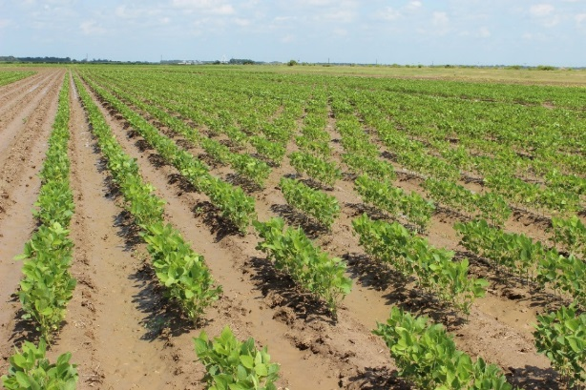
Advanced Line (R16-45) Regional Yield Test (2019 UP5L Yield Trial and Pre-foundation)
Name | Pedigree | 19 Yield (bu/ac) | % CK | FSS (R1) | 18 Yield (bu/ac) | % CK | FSS (R1) | 17 Yield (bu/ac) | % CK | FSS (R1)
R16-45 | R07-6669 x UA5612 | 77.1 | 108.9 | 4.2 | 67.8 | 96.0 | 2.4 | 75.3 | 91.7 | 1.7
. | . | . | . | . | . | . | . | . | . | .
Check mean |  | 70.8 |  |  | 70.9 |  |  | 82.1
CV |  | 8.8 |  |  | 5.8 |  |  | 7.5
LSD |  | 3.8 |  |  | 3.9 |  |  | 0
Grand mean |  | 64.0 |  |  | 68.3 |  |  | 75.0
2019 yield data only coming from 19 UP5L test at Keiser, AR
2018 yield data from 18 advanced test (FLF)
2017 yield data from 17 preliminary test (FLP)

Slide 34
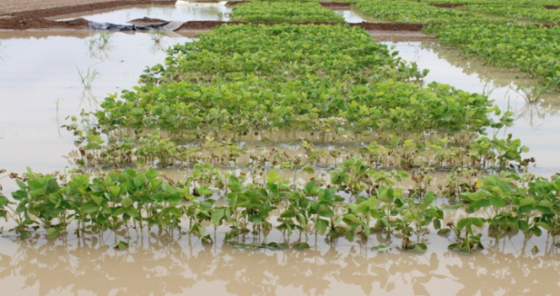
288 Preliminary lines Yield Tests (288 entries, 5 yield trials, 4 locs x 1 rep)
Name | Pedigree | Yield (bu/ac) | % CK | FSS
R18-7504 | N94-7440 x UARK-5896 | 71.1 | 116.8 | 3.6
R18-7519 | N94-7440 x UARK-5896 | 67.8 | 111.3 | 3.8
R18-7552 | N94-7440 x UARK-5896 | 60.6 | 99.6 | 3.6
. | . | . | . | .
Check mean |  | 60.9
CV |  | 15.8
LSD |  | 0
Grand mean |  | 55.9
Three lines show high-yielding and flood tolerant traits. A total of 42 lines yield large than 100% check mean.

Slide 35
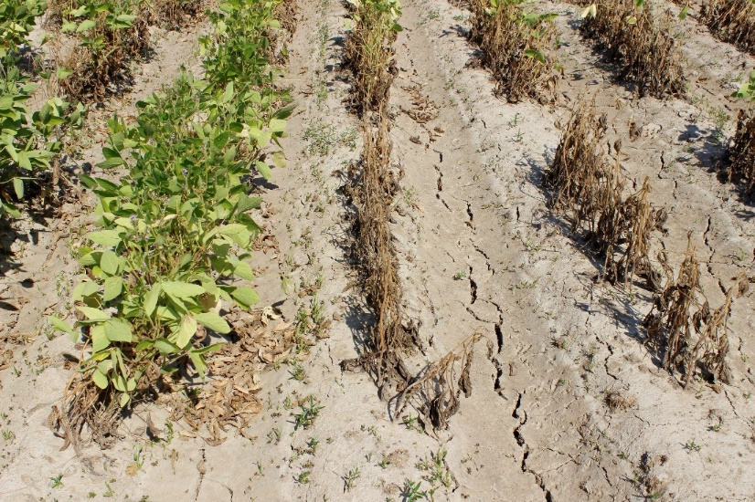
2020 Flood Screening and Breeding Plan
Flood Screening
AR advance/preliminary high-yielding lines
AR historical varieties/germplasm
Commercial varieties
Breeding for high-yield and flood-tolerance
Yield trials
Populations advance
New crosses
Collaborations
MSSB lines screening
Flood/Irrigation yield tests

Slide 36
2019 Soybean
Variety Flood Testing
Delta Research and Extension Center
Stoneville, MS
T. Wilkerson, D. Chastain

Slide 37
Varieties
Maturity groups (grouped by technology)
MG IV Early-EXTEND
MG IV Late-EXTEND
MG IV RR and ENLIST
MG IV Conventional
MG IV LibertyLink
MG V Early-Extend
MG V RR and ENLIST
MG V Conventional

Slide 38
Methods/ Evaluations
190 entries
Planted July 9, 2019
Sharkey clay (NRCS Soils)
RCBD, 4 replications
2 row plots, 40 inch centers, 9 seed/ft.
Flood v3/v4 for 6 days
Injury ratings 7 days after flood removed
0-9 rating scale for % incidence (FIS), % chlorosis + necrosis (FSS)
Unable to take yield due to low stand

Slide 39
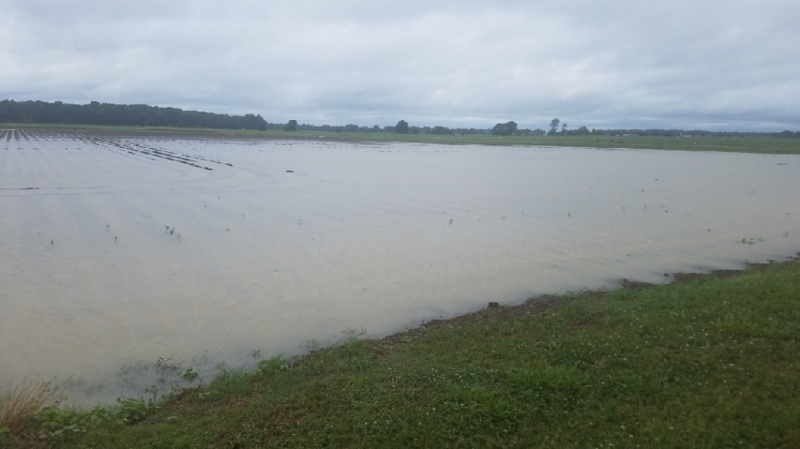
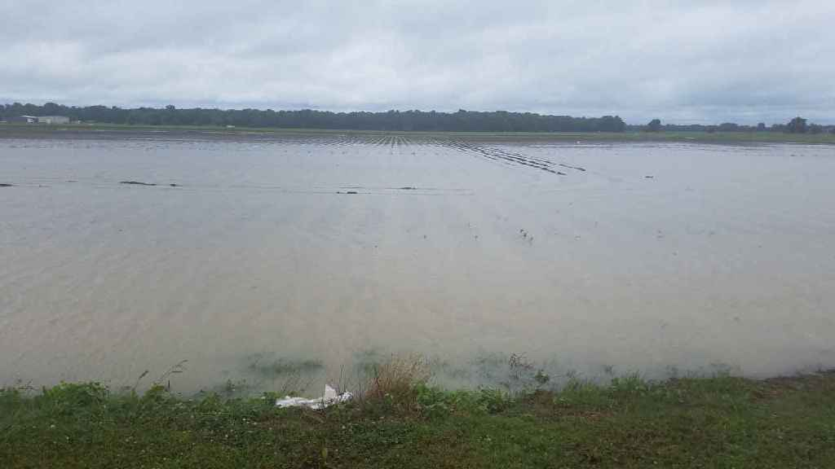
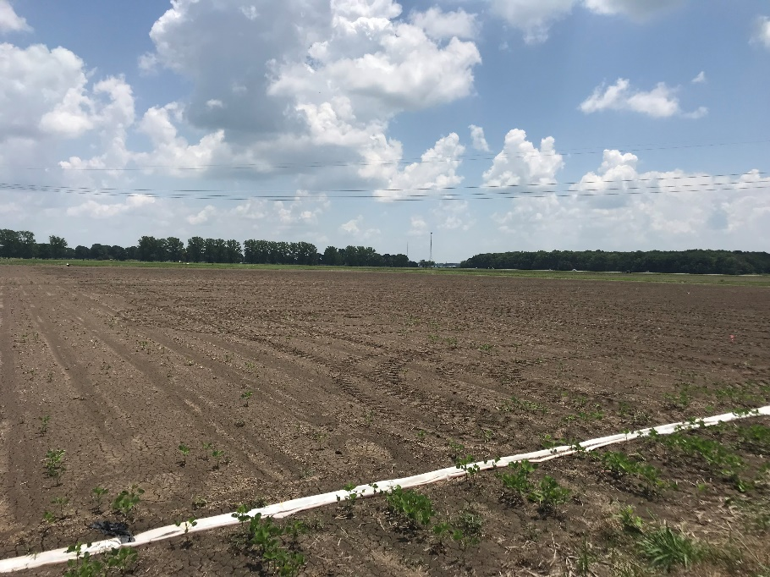
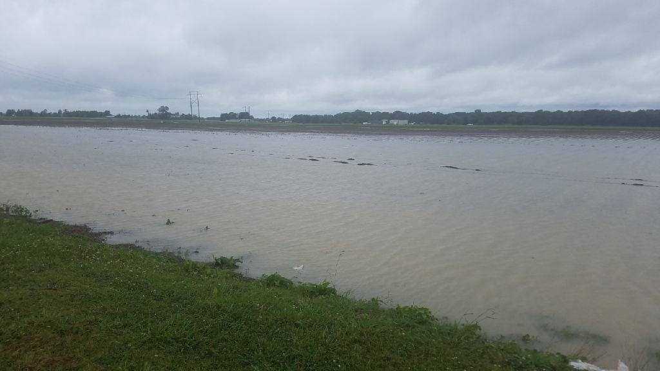
5 Days after planting
D. Chastain
D. Chastain
D. Chastain

Slide 40
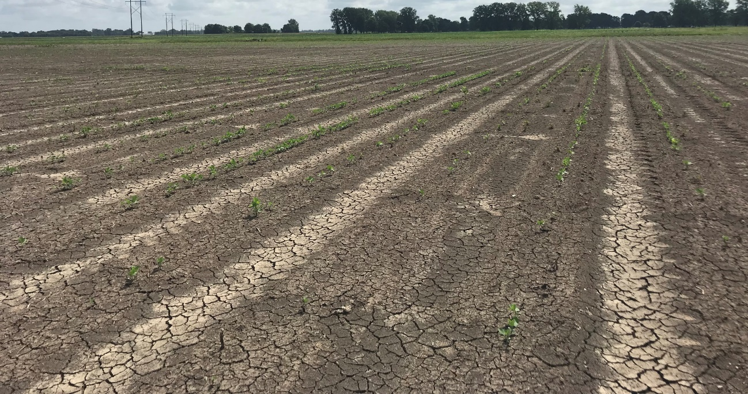
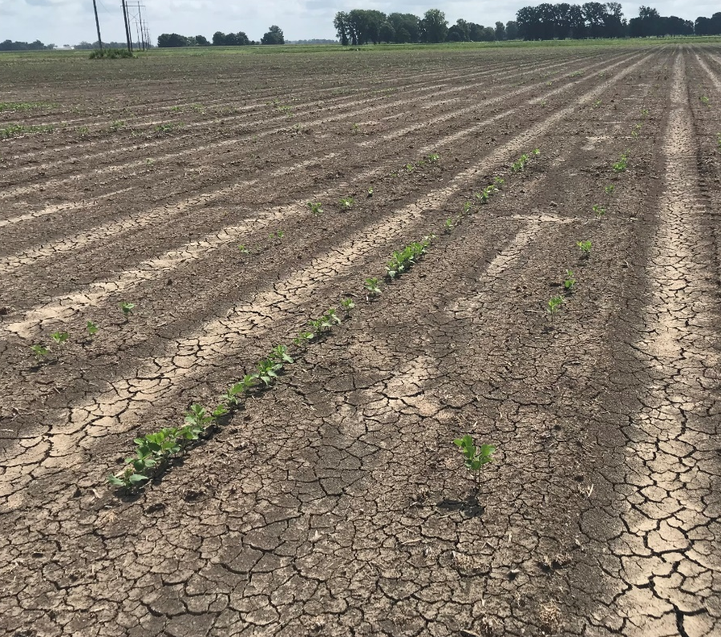
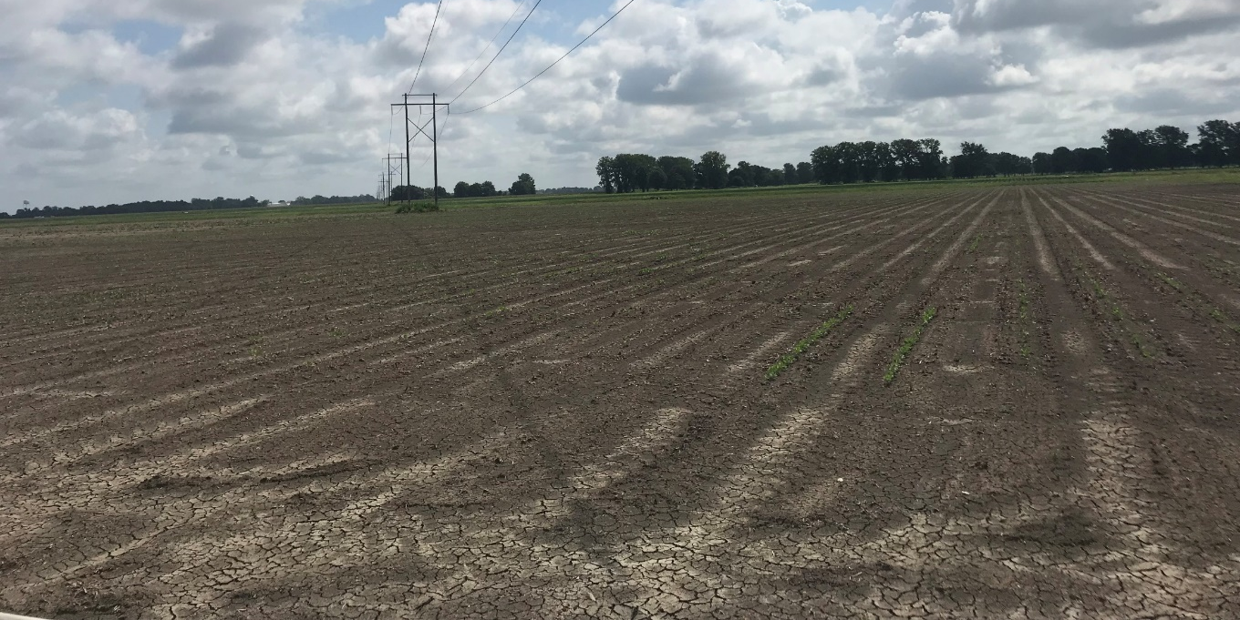
20 Days after Planting

Slide 41
MG IV Early-EXTEND
* Flood Incidence (range 0-4.25)
* Severity (range 0-1.25)
AgriGold G4605RX
Delta Grow 46X25
MG IV Late-EXTEND
* Flood Incidence (range 0-3.00)
Severity (range 0-1.50)
AgriGold G4990RX
Asgrow AG48X9
Don Mario 49J3X
Notes:
* Denotes significance

Slide 42
MG IV RR and ENLIST
Flood Incidence (range 0-3.50)
Severity (range 0-0.75)
Delta Grow 48E10
MG IV Conventional
Flood Incidence (range 0-1.50)
Severity (range 0-0.33)
J77-339
Univ. of Missouri S13-10590C (2019 Release)
Univ. of Missouri S16-14730C (New Release)
Virtue V4920S

Slide 43
MG IV LibertyLink
* Flood Incidence (range 0-6.50)
Severity (range 0-0.50)
Credenz CZ 3601 LL
MG V Early-Extend
* Flood Incidence (range 0-5.25)
Severity (range 0-1.25)
Progeny P5688RX

Slide 44
MG V RR and ENLIST
* Flood Incidence (range 0-2.75)
*Severity (range 0-0.75)
Delta Grow 5585 RR2/STS
MG V Conventional
Flood Incidence (range 0-0.75)
Severity (range 0-0.50)
Univ. of Missouri S11-17025
Univ. of Missouri S13-1955C (2019 Release)

Slide 45
Summary
Wet spring/ early summer rains caused issues with emergence.
Differences within maturity groups with regard to flood incidence and severity.
This year’s data suggests most varieties have some natural tolerance to flood
Yield wasn’t taken due to low stand
2020 Plans
Repeat study with 2020 state variety trial entries.

Slide 46
Contact Info:
Tessie Wilkerson
twilkerson@drec.msstate.edu
Office: 662-686-9311 ext. 277
Mobile: 662-820-0549
Daryl Chastain
drc373@msstate.edu
(662) 686-3245

Slide 47
2019 Soybean Flood Trials – Bossier City, LA

Slide 48
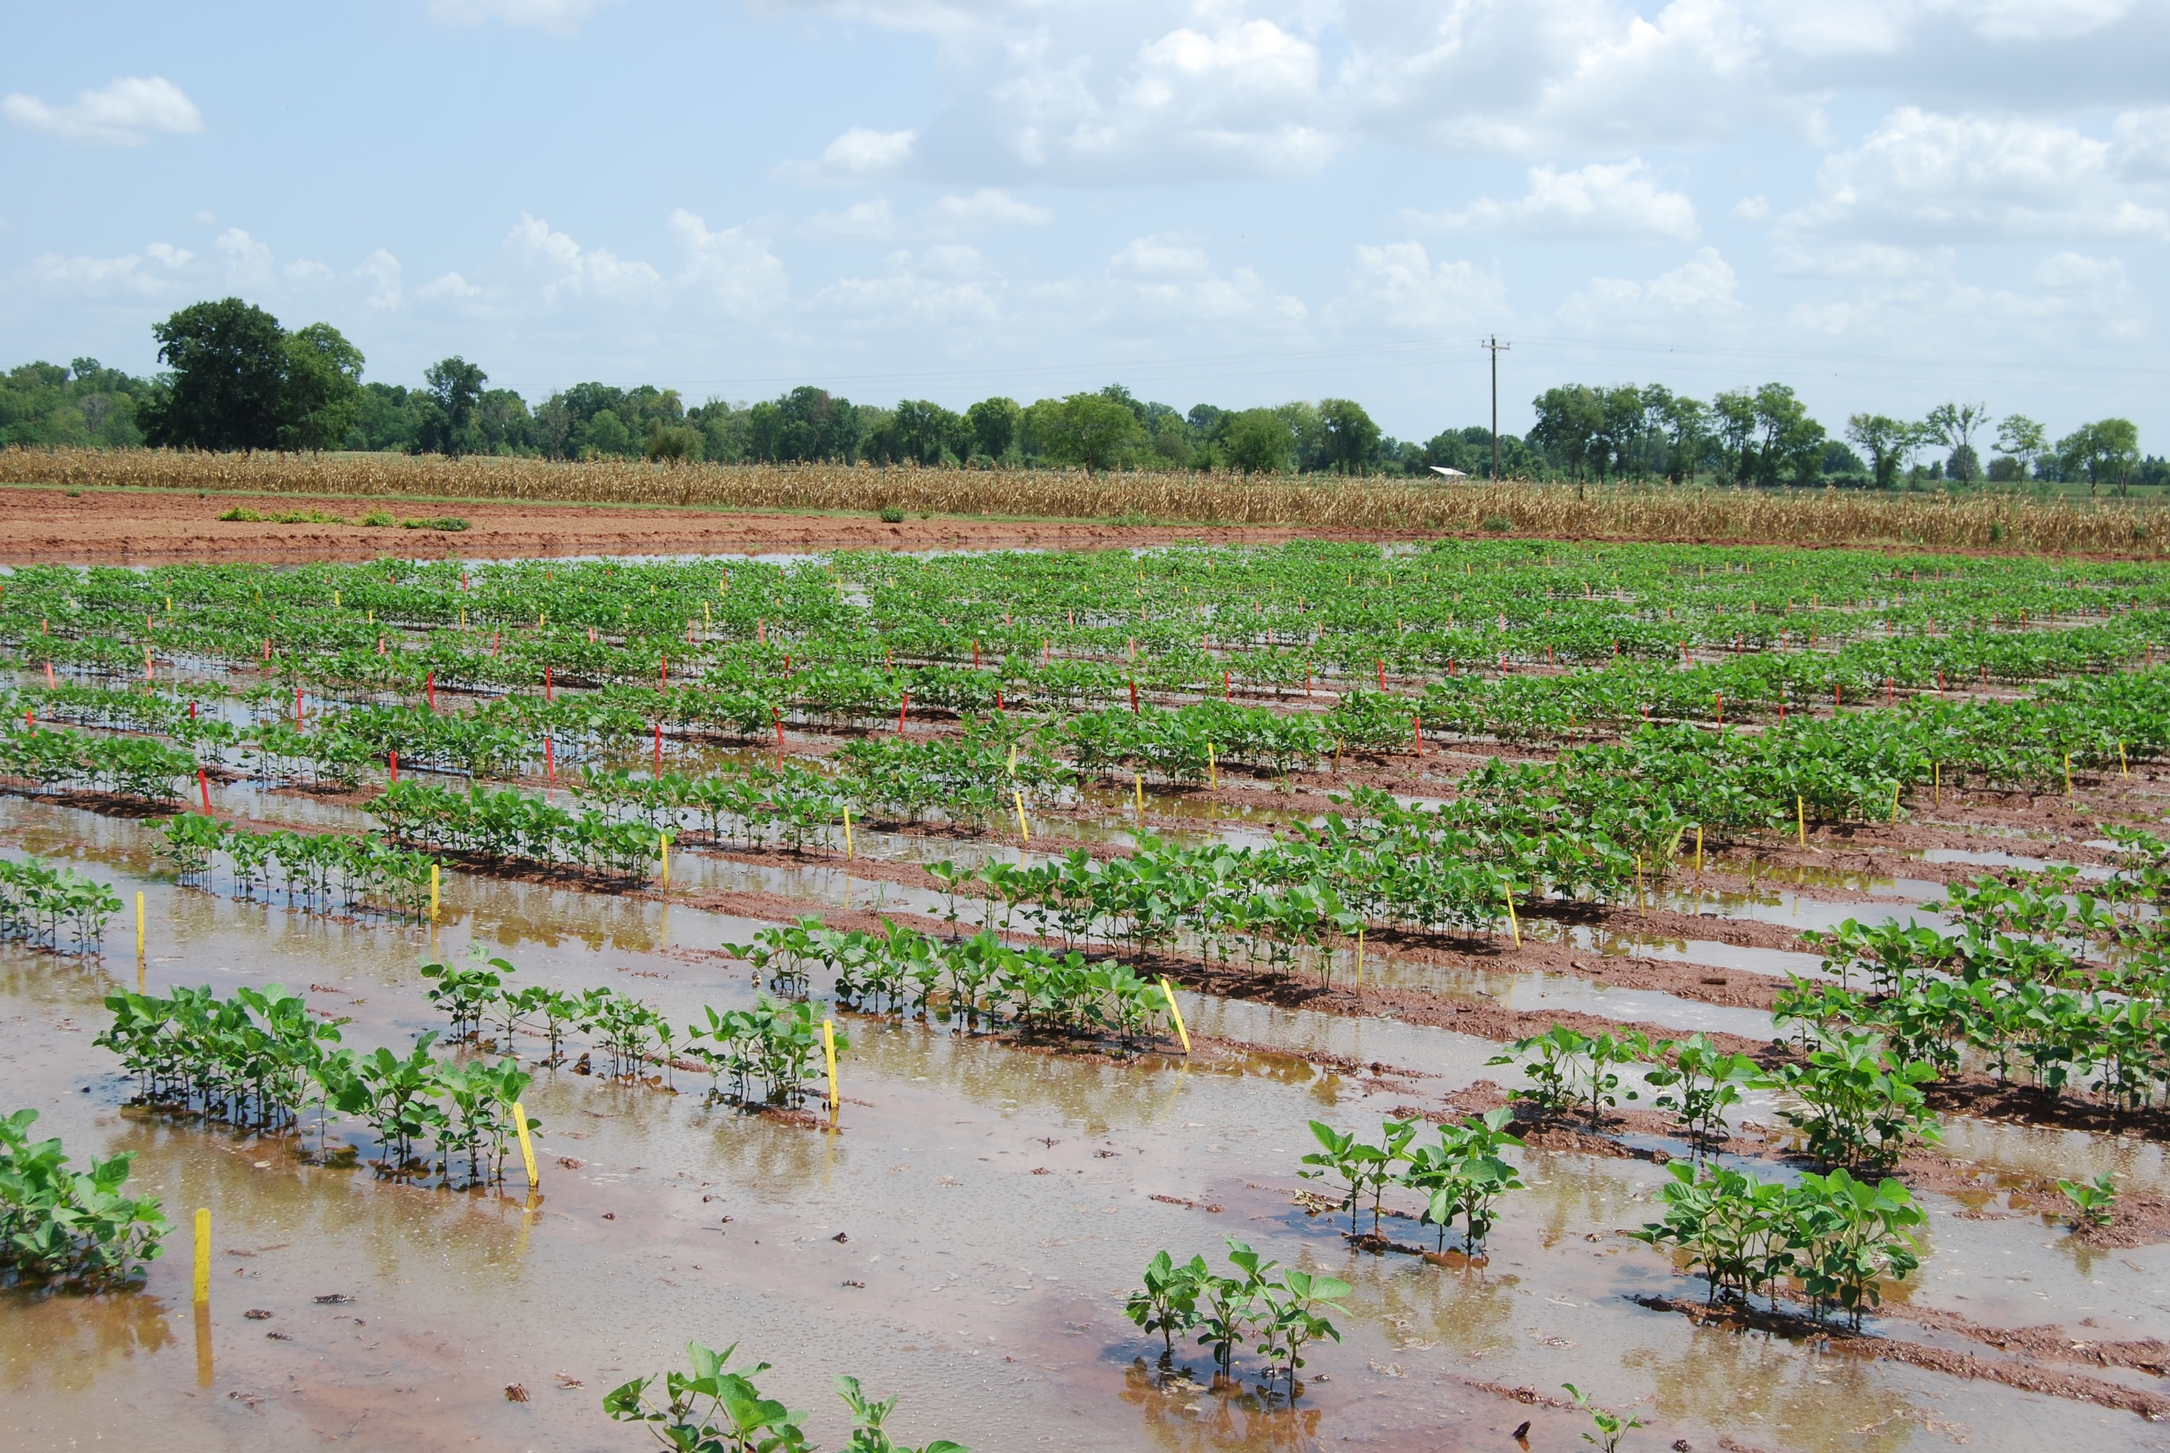

Slide 49
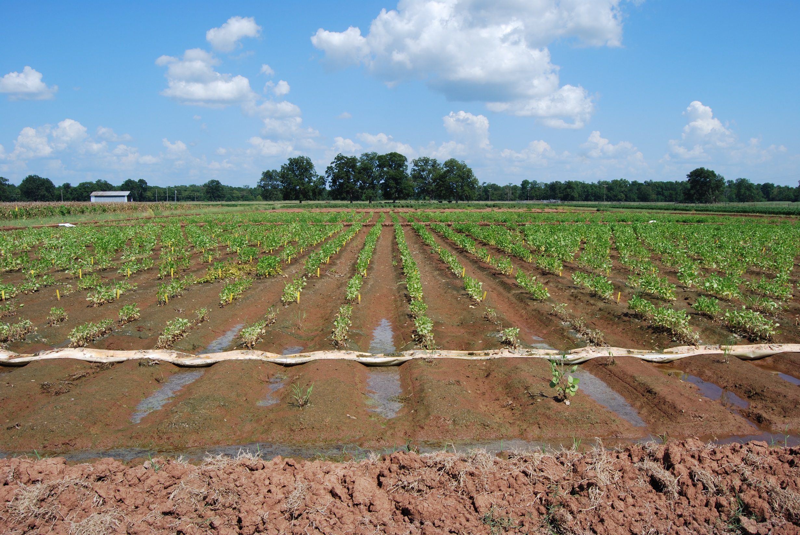
POST FLOOD

Slide 50
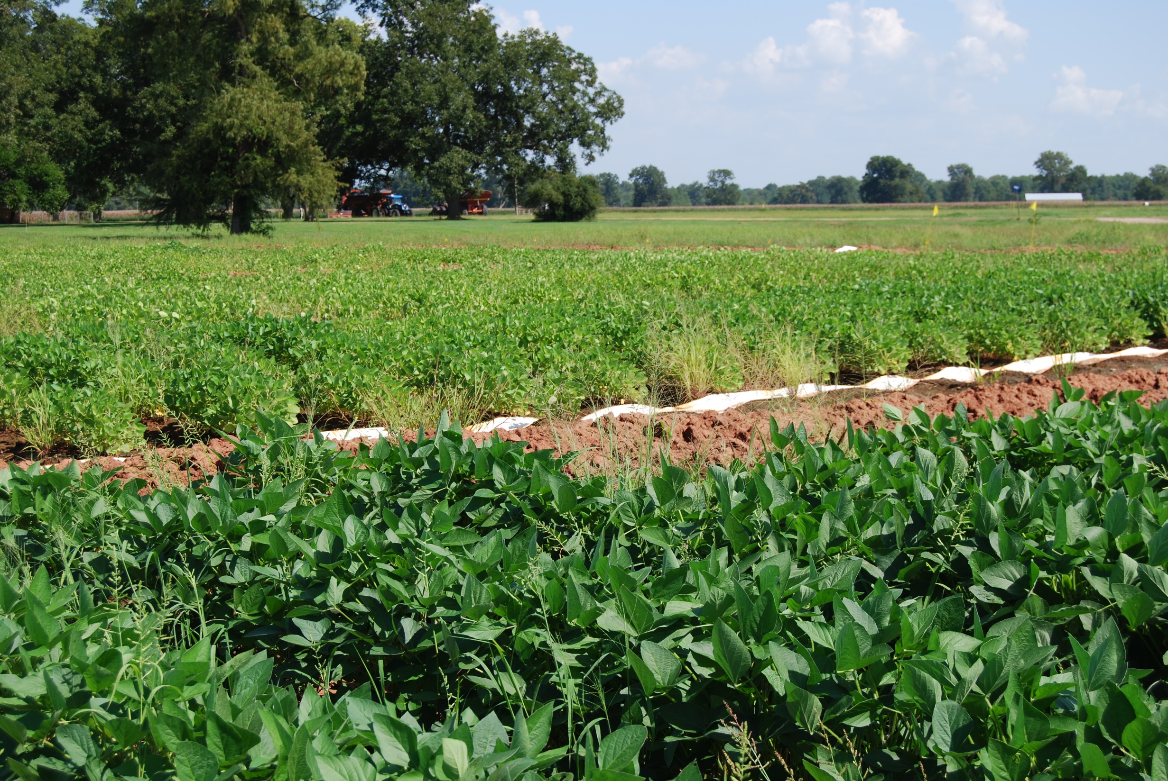
FLOOD
NON-FLOOD

Slide 51
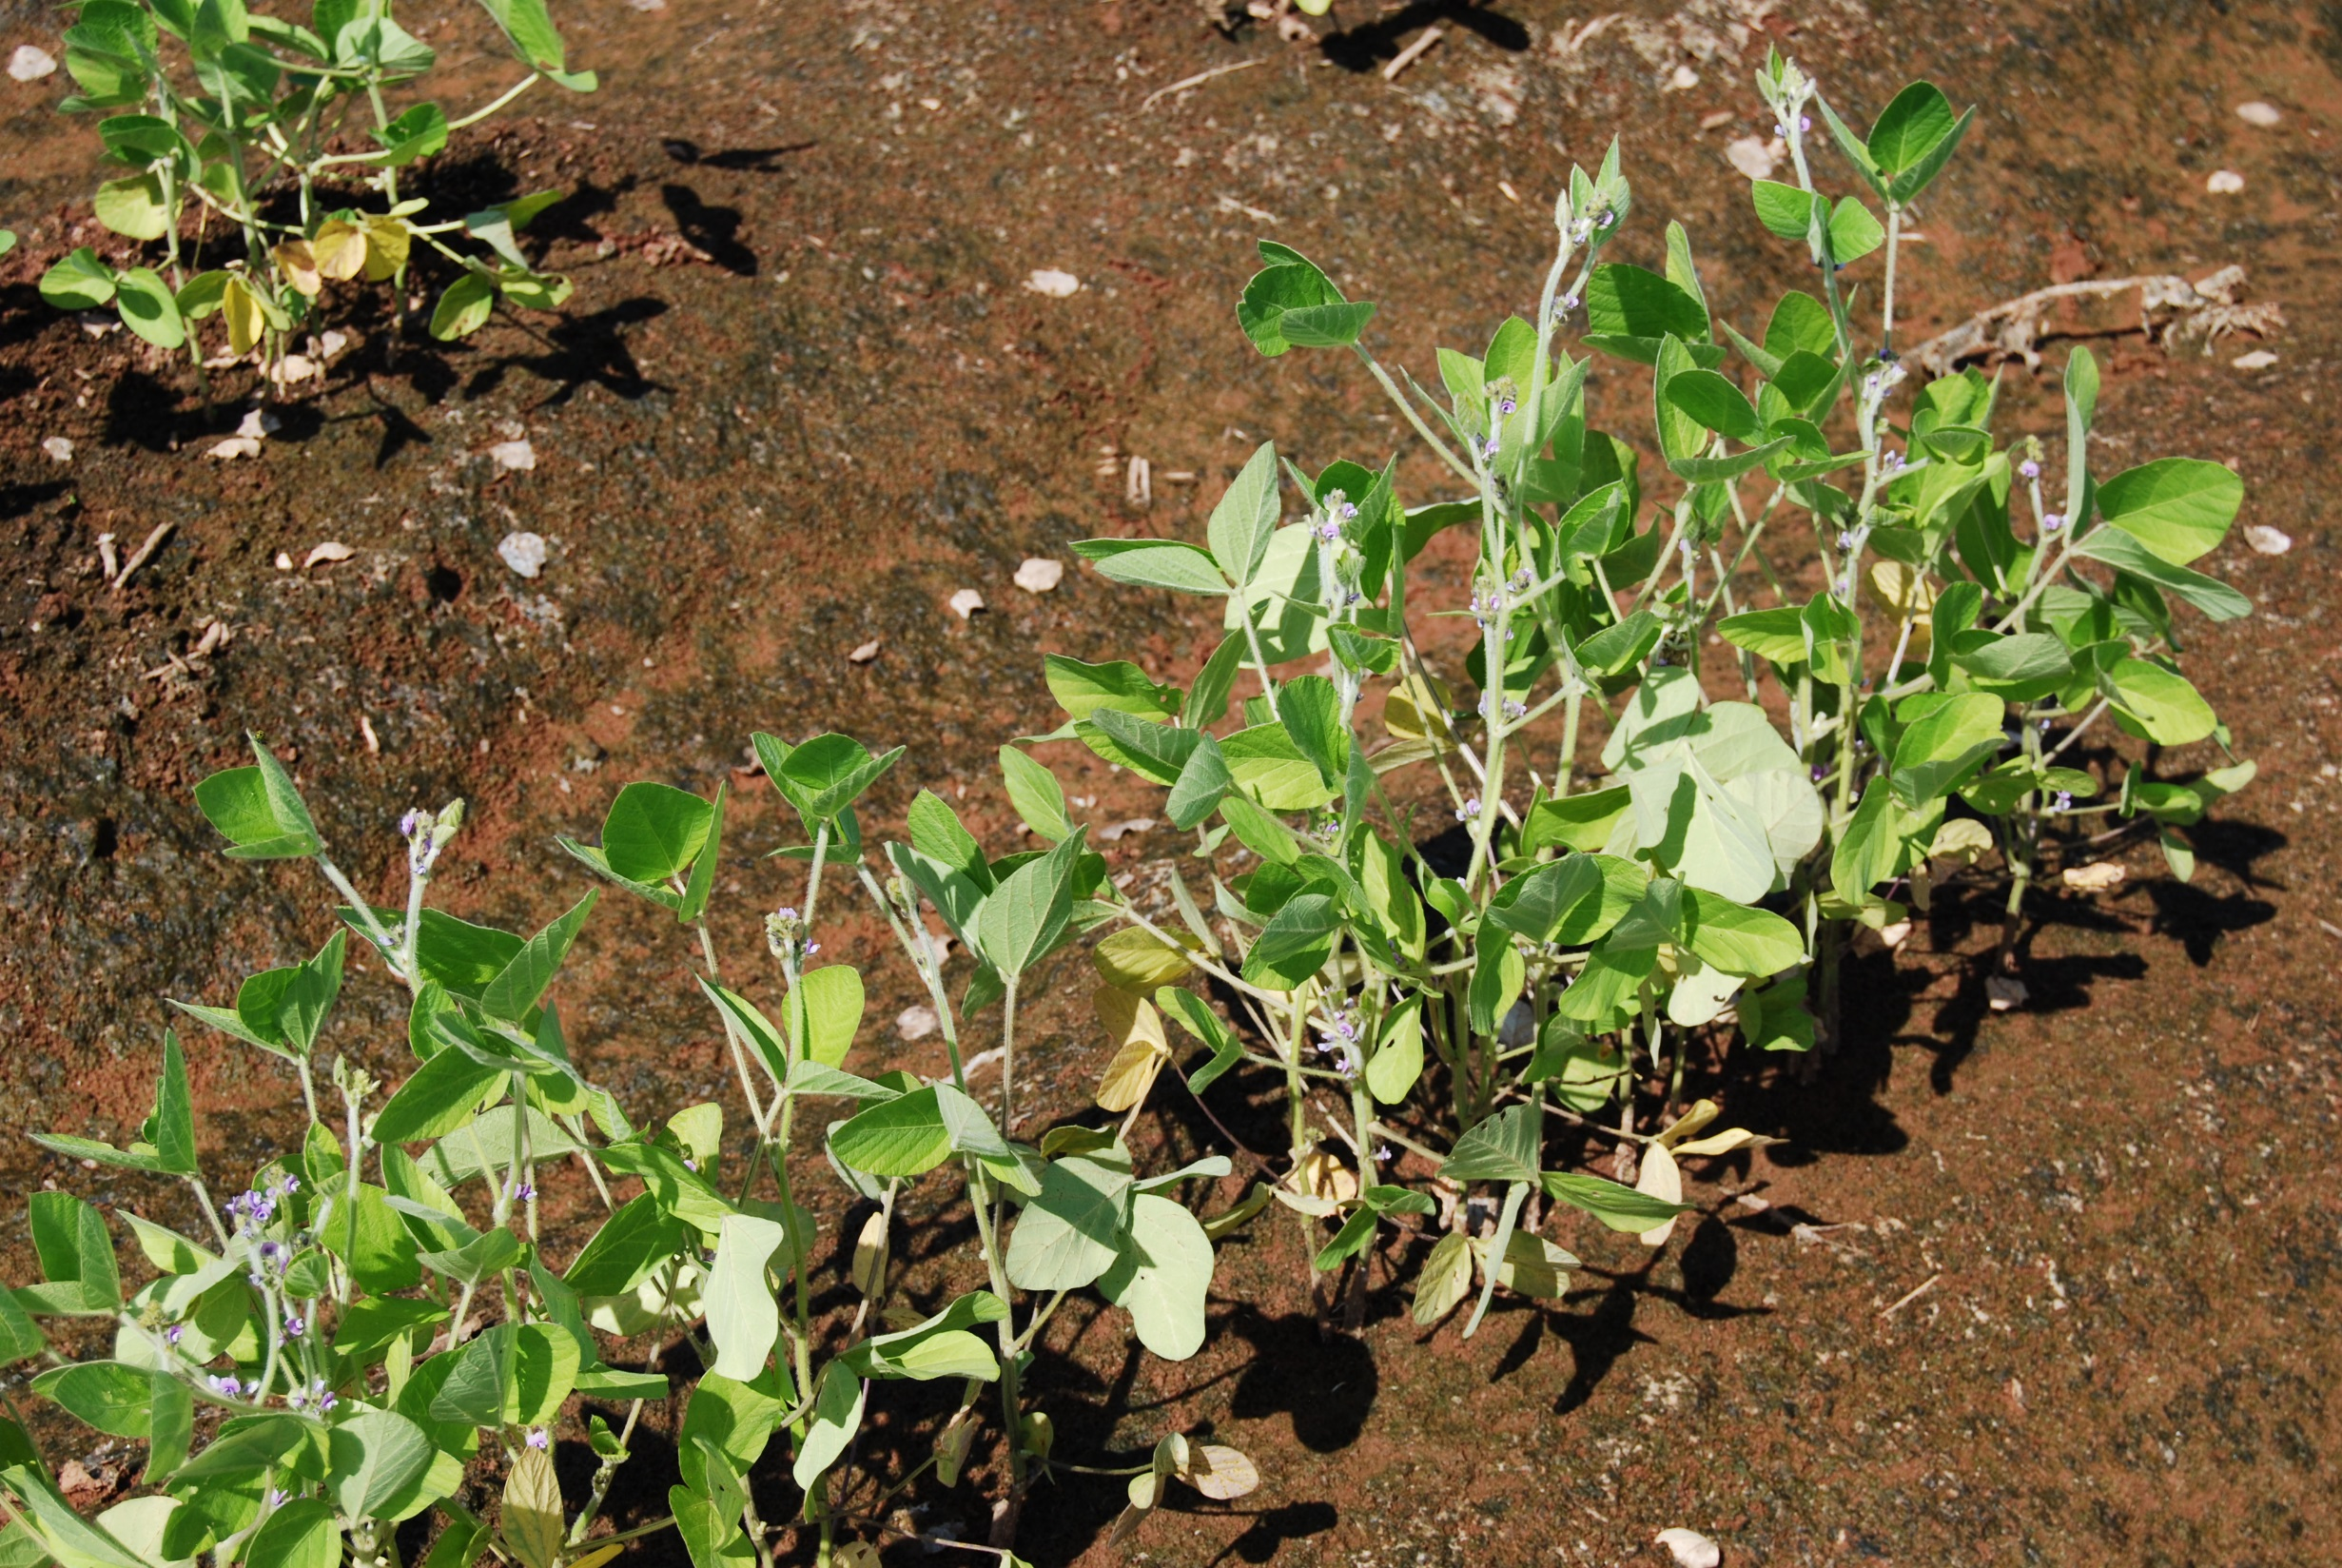
POST FLOOD

Slide 52
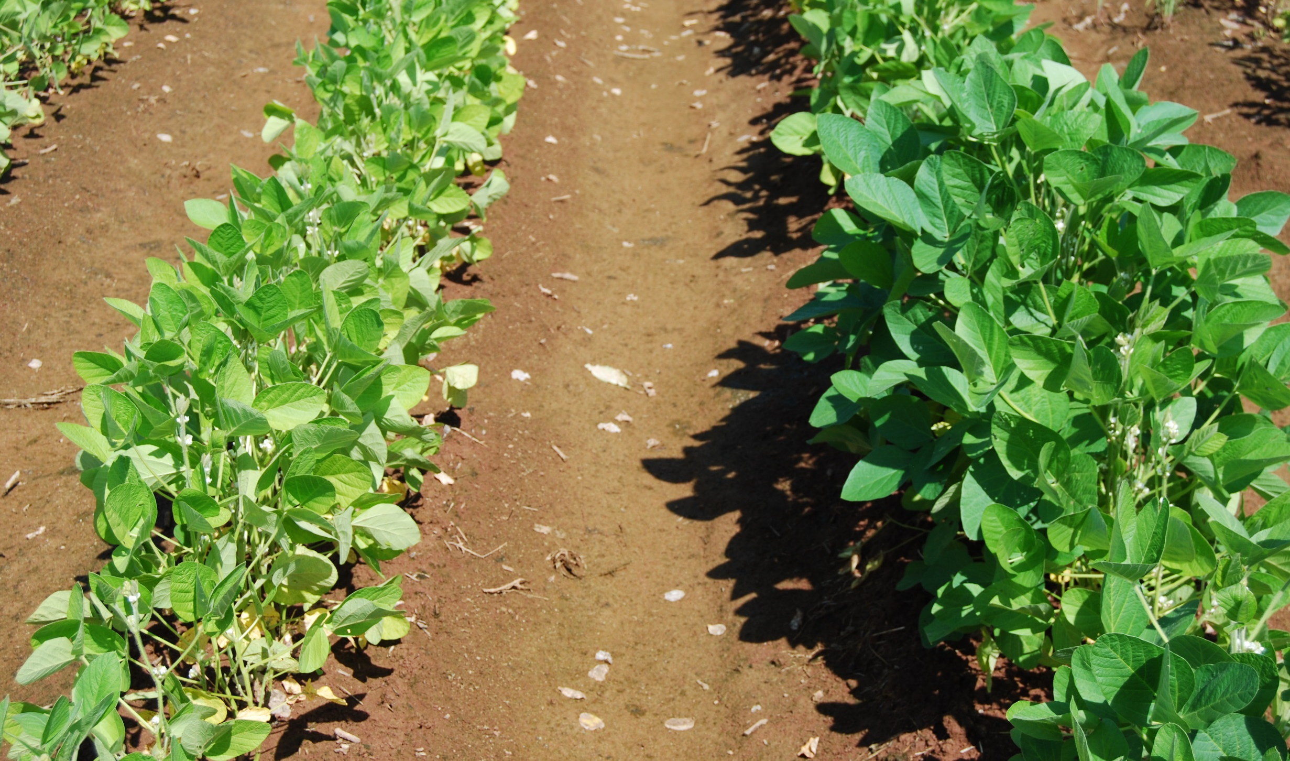
~3 WEEKS POST FLOOD

Slide 53
2019 Flood/Non-flood Trial

