Slide 1
Spray Application of Double Stranded RNA for Simultaneous Management of Multiple Soybean Fungal and Insect Diseases
Renewal Proposal Overview
ZHI-YUAN CHEN
Dept of Plant Pathology and Crop Physiology, LSU Agricultural Center

Slide 2
Limitations of fungicides and pesticides in managing plant diseases
Repeated applications cause development of resistance in pest/pathogen populations and reduced efficacy
Take a long time to develop a new chemistry for plant disease management, leaving our growers with very few choices
Usually not very specific to one pathogen or pest, has a broad-spectrum toxicity
Cause environmental pollutions

Slide 3






RNA interference-gene silencing by double-stranded RNA (dsRNA)
dsRNA
DCL: Dicer like protein
Cytoplasm
Dicer/DCL
AGO
RISC
AGO
AGO
m7G
dsRNA
RISC
Cleavage of mRNA
Nucleus
AGO
RISC
AGO
RISC
Chromatin
modification
AGO
m7G
Degradation
RISC
Translational
inhibition
RISC: RNA Induced Silencing Complex

Slide 4
Advantages of using dsRNA in disease management
DsRNA itself is non-toxic. No toxicity to none target organisms and environment. Use toxic information to control disease. Highly specific.
Low risk of developing resistance in pathogen or pest populations.
Multiple fungal and pest diseases can be controlled simultaneously.
Sources of dsRNA: transgenic expression of pathogen/pest dsRNA in plants or application of in vitro synthesized or bacterial produced dsRNA

Slide 5
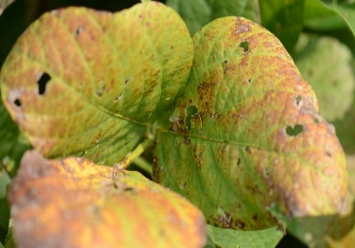
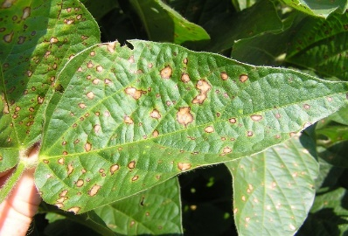
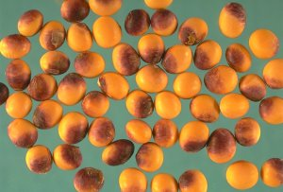
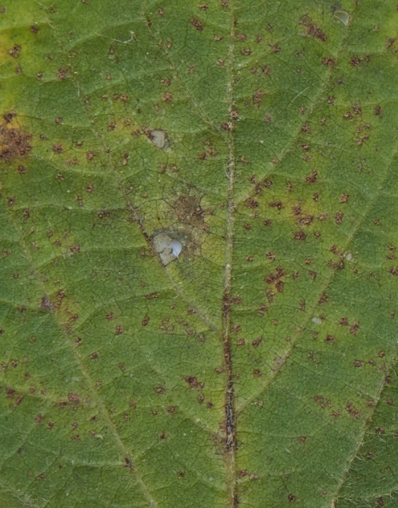
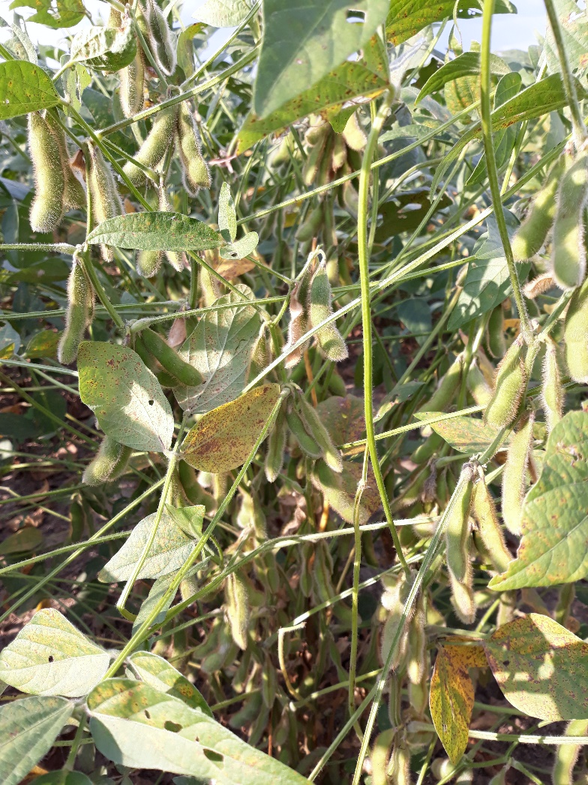
Major soybean fungal pathogens in the southern U.S.
Cercospora leaf blight, purple seed stain caused by C. kikuchii and C. cf. flagellaris
Frogeye leaf spot caused by C. sojina
Zhi-Yuan Chen
The pathogen often produces cercosporin as a virulence factor
Soybean rust disease caused by Phakopsora pachyrhizi
It is still very much a real threat to US soybean production
Trey Price, LSU Agcenter
http://www.seedquest.com/News/releases/2006/september/16913.htm
Zhi-Yuan Chen
Taken on August 20, 2020

Slide 6
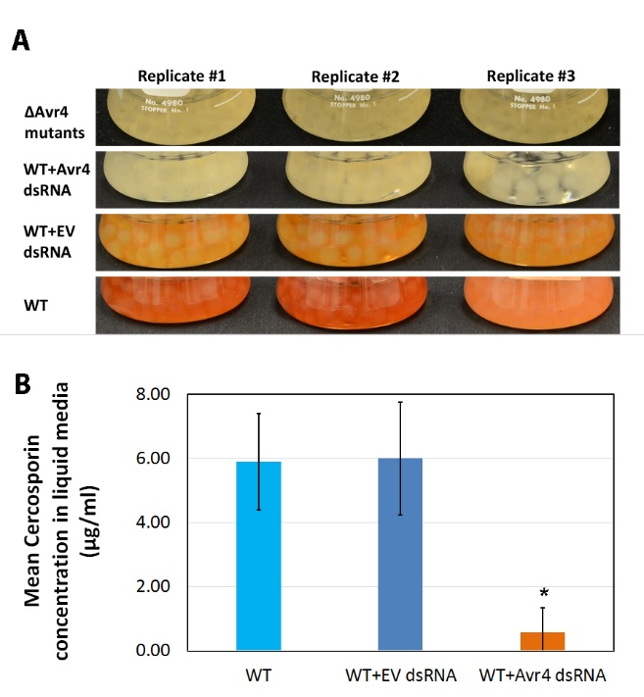
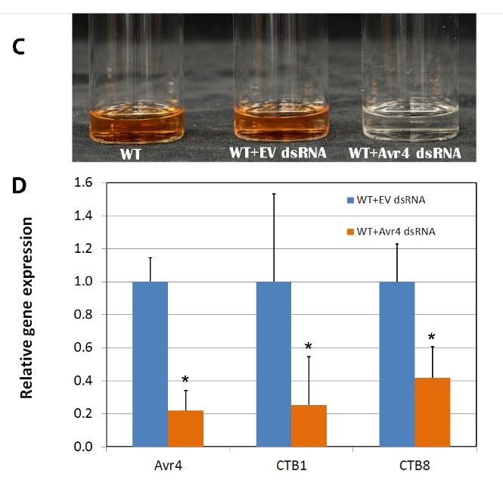
Avr4 dsRNA treated Cercospora cf. flagellaris cultures produced little to no cercosporin

Slide 7
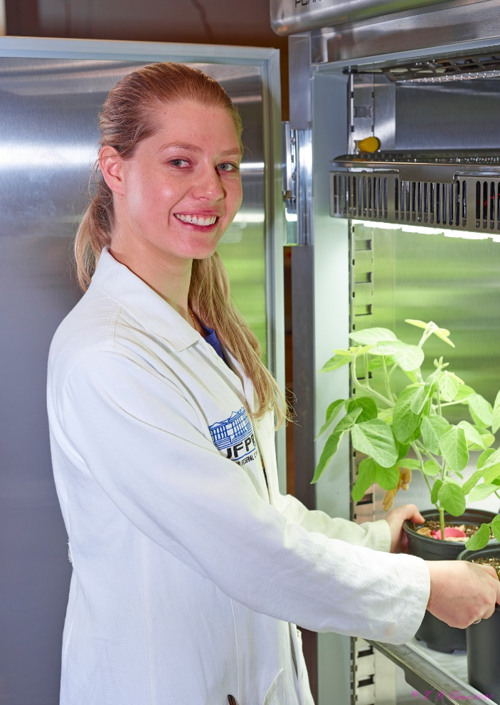

Slide 8
Overall objective of our proposal?
This proposed study attempts to eventually achieve a simultaneous management of multiple soybean fungal and insect diseases through direct spray application of dsRNAs

Slide 9
What have we achieved in year 1?
Produced dsRNA targeting different genes of Cercospora cf. flagellaris and rust in E. coli cells. We have constructed four dsRNA expression vectors and produced dsRNAs from the Avr4, CTB1, CTB8 and CYP51.
We have completed the evaluation of topically applied CTB1, CTB8, Avr4 and CYP51 dsRNAs on reducing soybean frogeye leaf spot (FLS) disease in growth chambers. The greenhouse evaluation is on-going.
Commercial soybeans (Syngenta S42-B9XS) have been planted (first planting was on May 4, second on May 25, and the last planting was on June 8) at Ben Hur Research Station.
Some of these plants have been treated with dsRNAs to evaluate the effectiveness of these dsRNAs in reducing CLB and FLS under natural infection conditions when the plants reach V4-5 stages.

Slide 10
Constructed dsRNA expression vectors and Produced dsRNAs in E. coli
DsRNA production:
  Induce dsRNA production with IPTG
  Harvest bacterial cells and store at -80°C
  Lyse bacterial cells with French press three times at 1000-1250 psi
  Chloroform extraction
  Ethanol precipitation at -80°C 20 min
  Dissolve dried dsRNA in DEPC water
Figure 1. Construction and production of dsRNAs in a bacterial expression system. A. the vector we used to put our target genes from Cercospora pathogens; B. the production of dsRNAs in E. coli cells after induction.

Slide 11
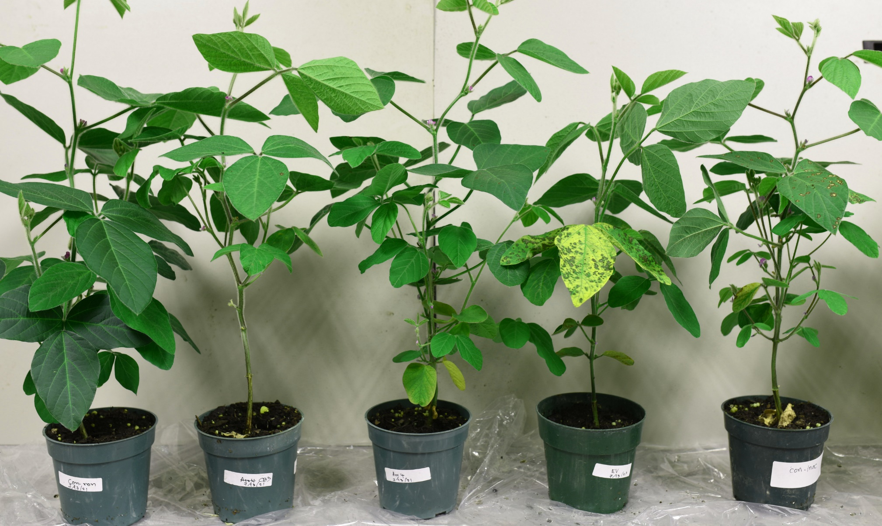
dsRNA application of soybean plants in growth chamber for managing Cercospora diseases
Soybean variety used here is Syngenta S49-F5X
Non-sprayed, Non-inoculated
CYTB-sprayed, inoculated
Avr4-sprayed, inoculated
EV-sprayed, inoculated
Non-sprayed, inoculated
Notes:
Each treatment uses 3 pots with 6 plants, with 2 trifoliate leaves from each plants were sprayed with dsRNA. The C. sojina inoculation was on the two leaves

Slide 12
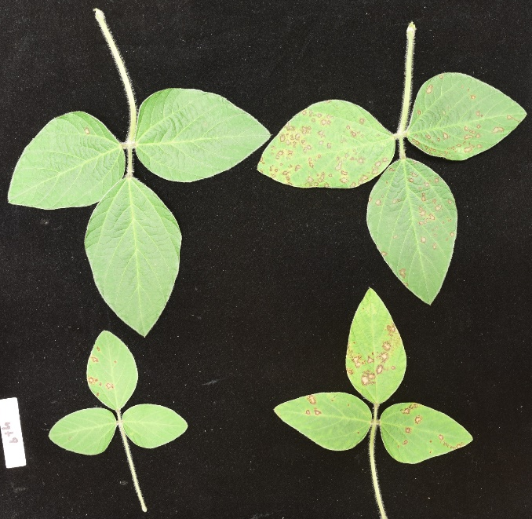
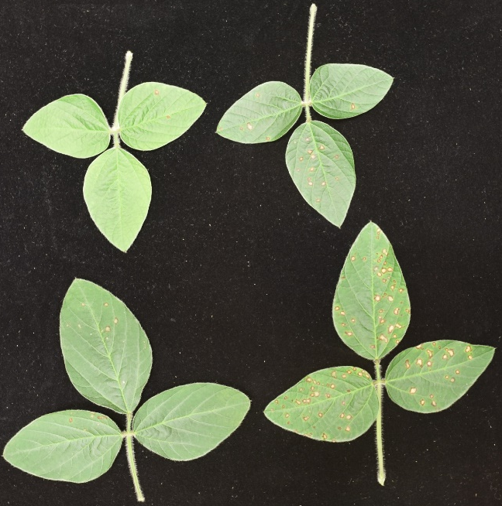
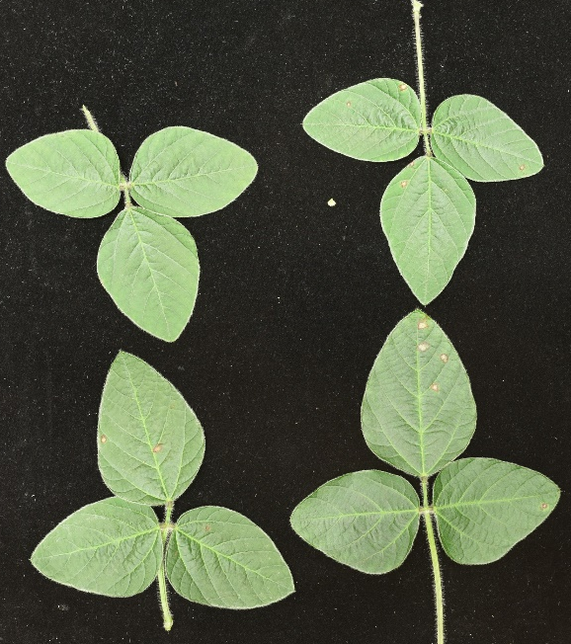
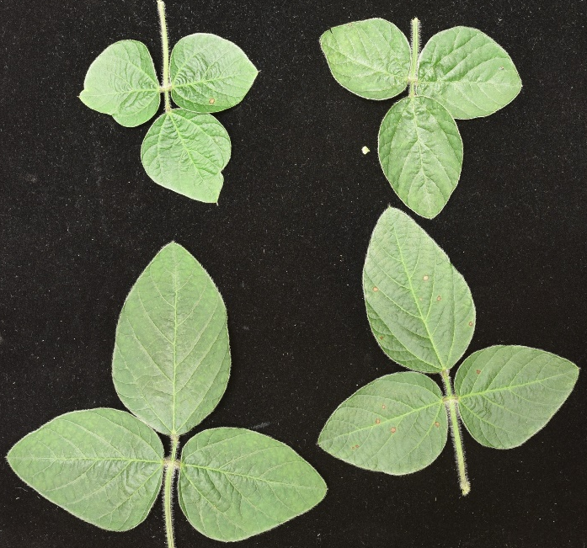
dsRNA application of soybean plants in growth chamber for managing FLS
Non-sprayed, inoculated
EV-sprayed, inoculated
CYTB-sprayed, inoculated
Avr4-sprayed, inoculated
We have repeated this study 6 times in the growth chambers with similar results of disease reduction in those leaves treated with dsRNA
Notes:
Each treatment uses 3 pods with 6 plants, with 2 trifoliate leaves from each plants were sprayed with dsRNA. The C. sojina inoculation was on the whole plants

Slide 13
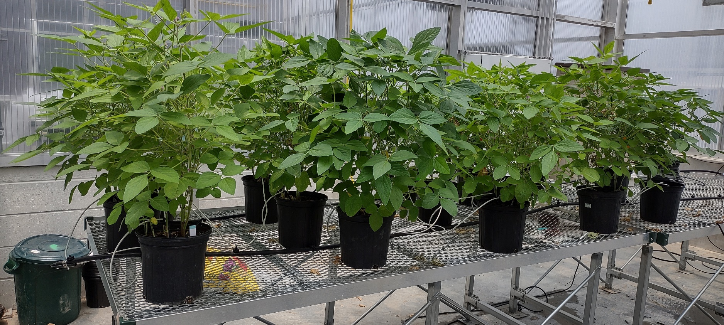
Tested the effect of topically applied dsRNA in reducing frogeye disease in greenhouse
Figure 2. Soybean plants grown in the greenhouse that had been treated with several dsRNAs for controlling Cercospora diseases before inoculation with C. sojina spores that cause Cercospora frogeye leaf spot disease.

Slide 14
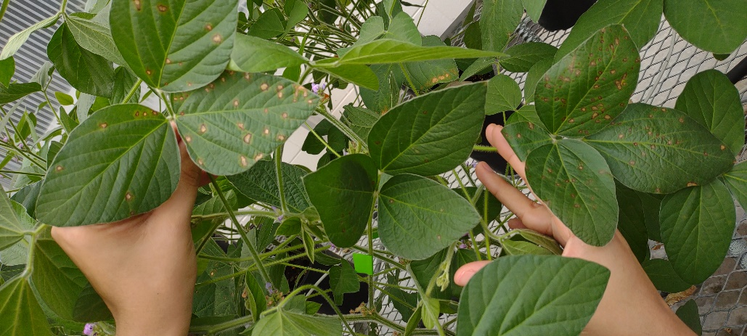
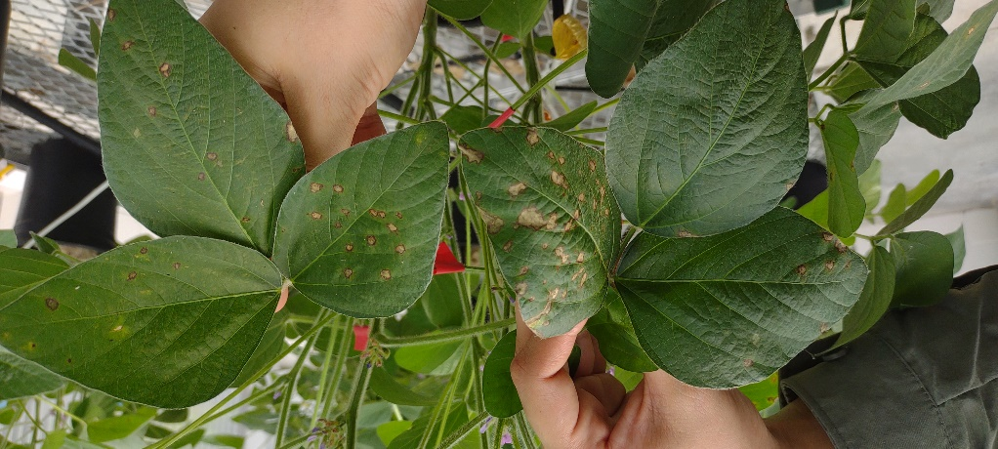
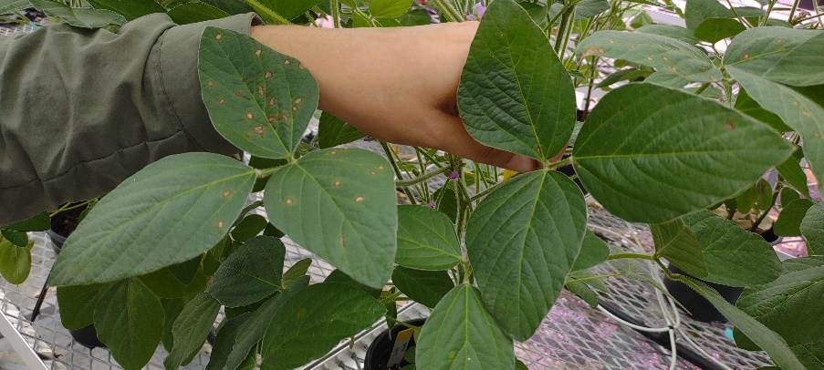
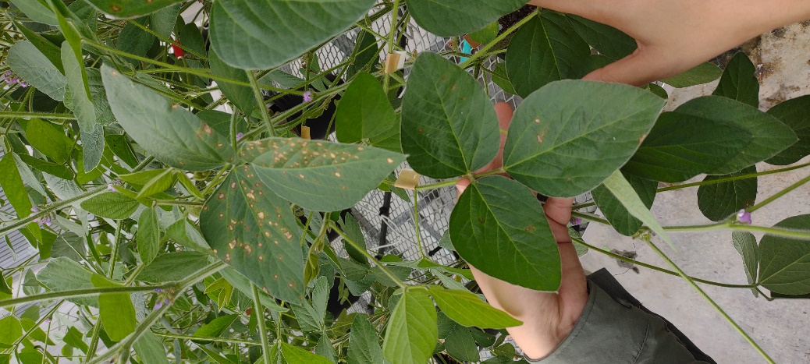
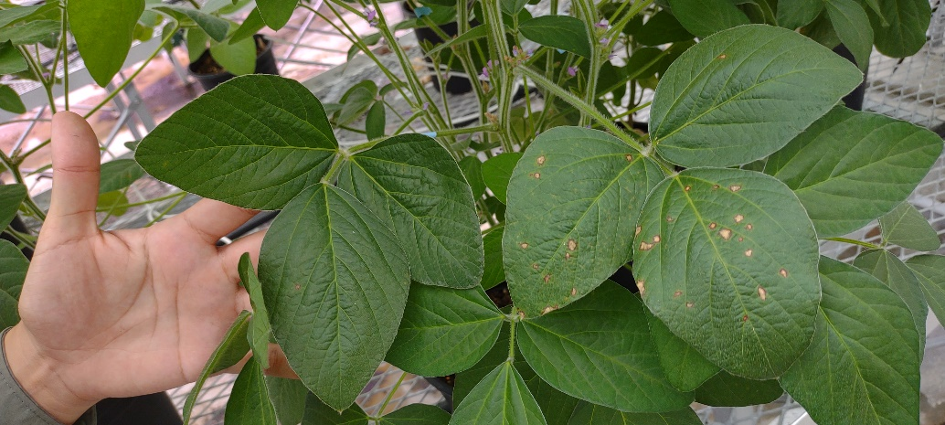
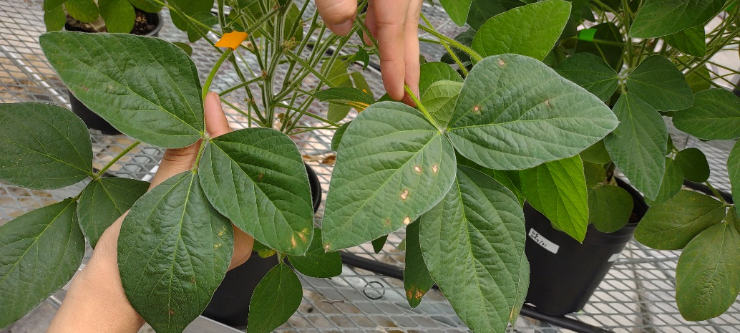
DEPC
EV
CYP51
CTB8
CTB1
AVR4

Slide 15
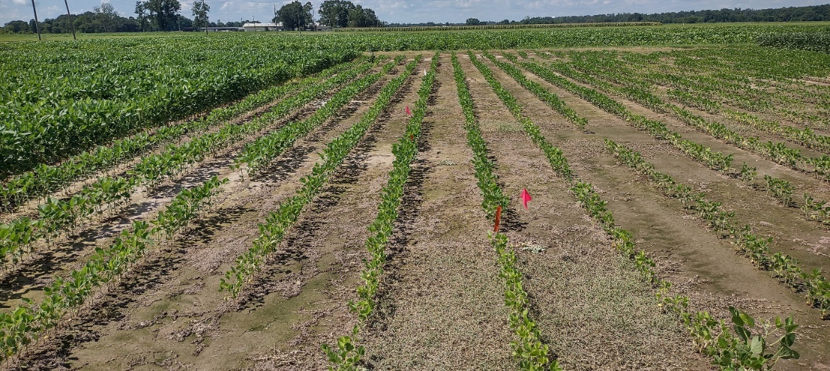
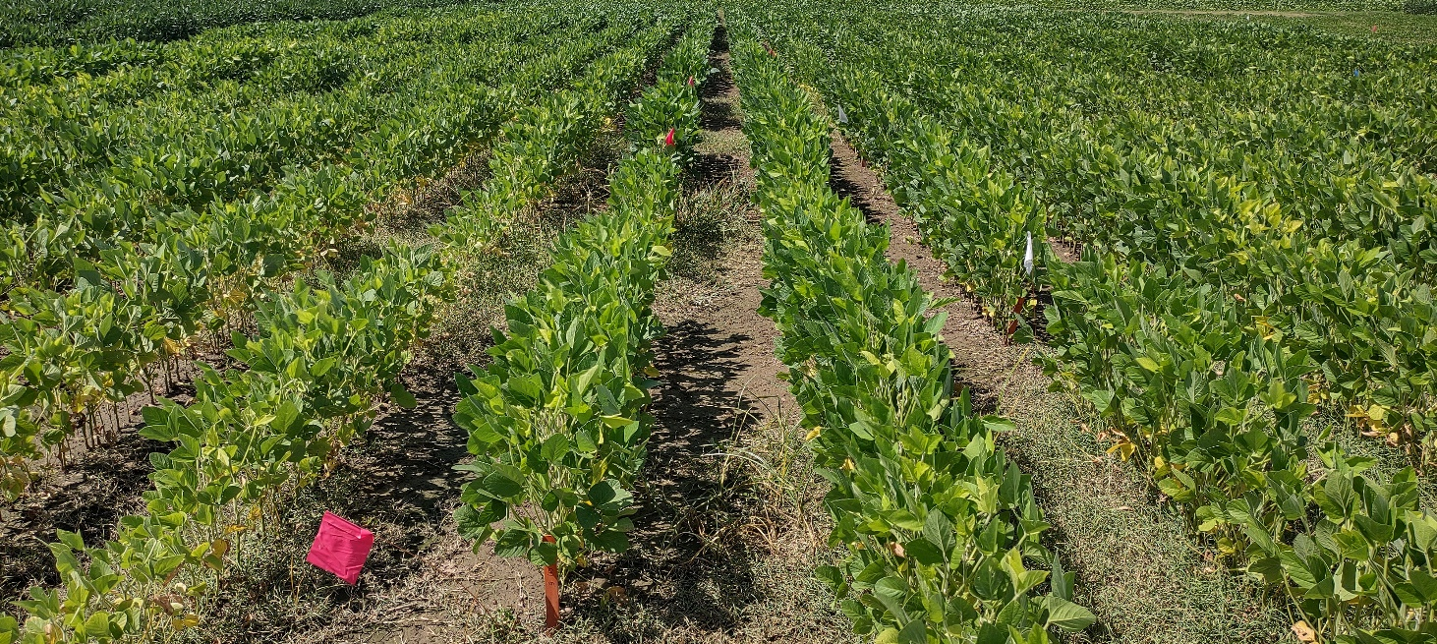
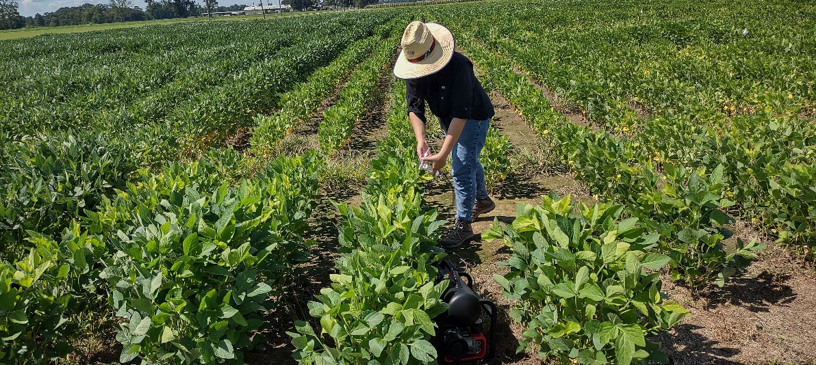
Small scale field dsRNA application
Spraying dsRNA onto soybean plants
The soybean variety used here is Syngenta S42-B9XS

Slide 16
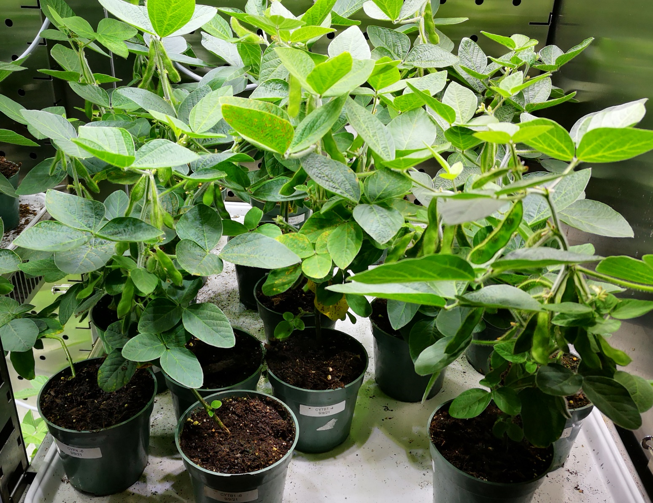
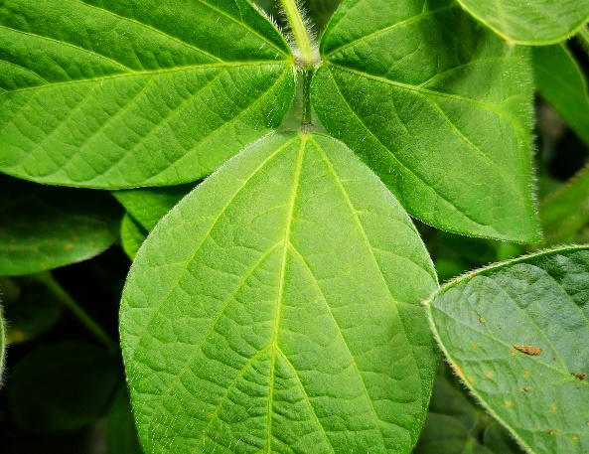
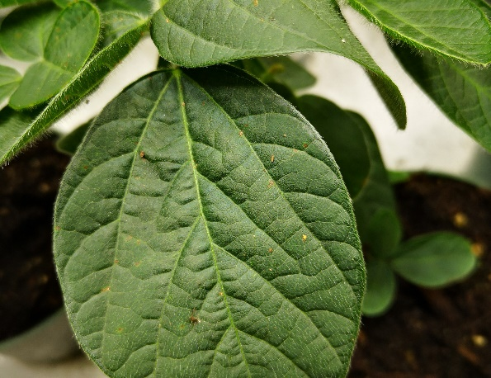
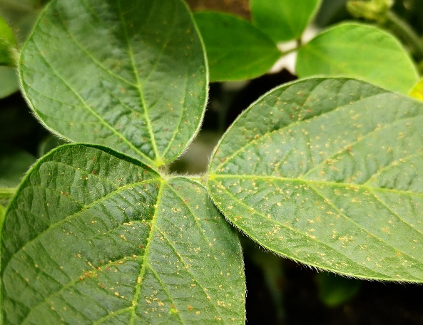
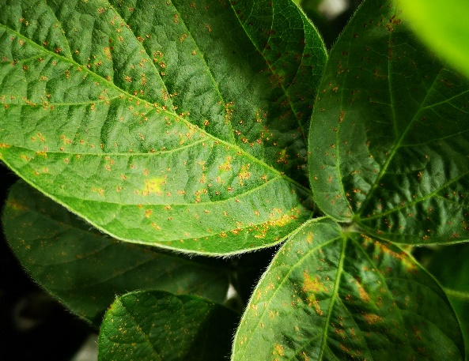
dsRNA application of soybean plants in growth chamber for managing soybean rust
We have repeated this study 3 times in the growth chambers with similar results of disease
H12 dsRNA
ATC dsRNA
CYP3 dsRNA
EV dsRNA (CK)
Notes:
Cytochrome p450 family 3:CYP3.

Slide 17
Objectives for 2023
Fine-tune the conditions to effectively deliver dsRNA into soybean plants;
Examine the potential of nano-particles in enhancing dsRNA stability on leaf surface; and
Determine the effectiveness of these dsRNAs in simultaneous management of CLB, FLS, and PSS through spray applications in greenhouse/field conditions.

Slide 18
Acknowledgement
Dablieny Souza, Ph. D. student (started in Jan, 2022)
Yenjit Raruang, Post doctorate, 2020-
Supported by Louisiana State Soybean and Small Grain Promotion Board and Mid South Soybean Board

